Slide 1
7.1 The Geometric Mean

Slide 2
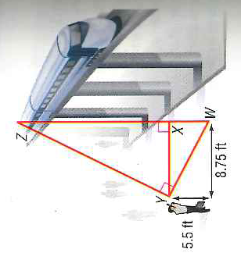
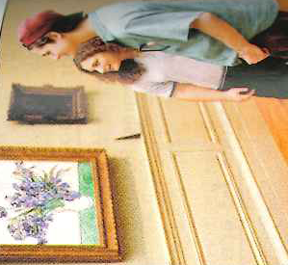
7.1 Geometric Mean: Examples

Slide 3
Theorems From 7.1: Geometric Mean
Hmwr/challenge: Show how these theorems are true

