Slide 1
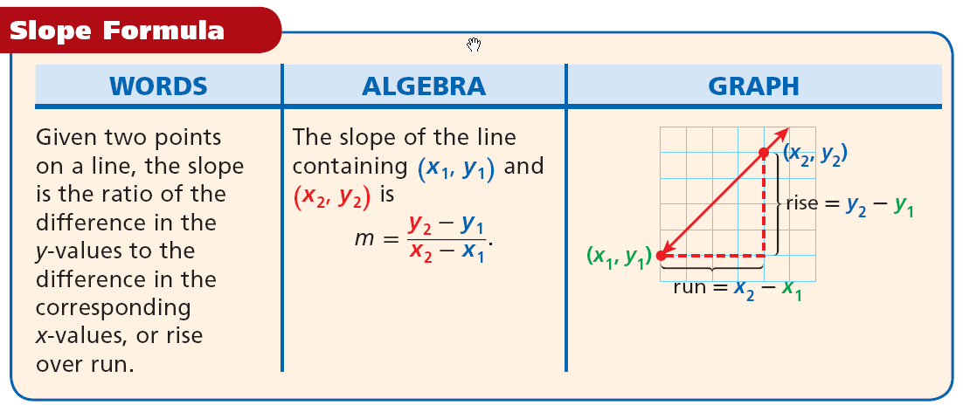
The Slope of a Line:
Real life example: Rate of Change How Much did I change?

