Slide 1
3.1 Extrema on an Interval

Slide 2
Questions that will be answered in Chapter 3:
Does f have a maximum or a minimum value?
Where is the function increasing or decreasing?
Applications?
Derivative will help us!

Slide 3
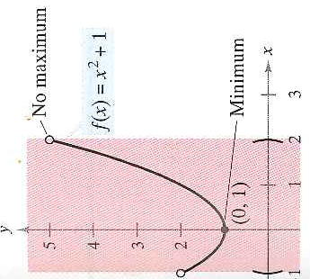
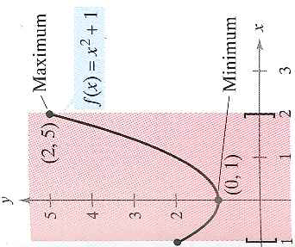
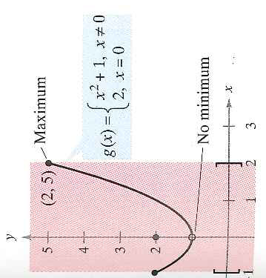
3.1 Extrema on an Interval

Slide 4
3.1 Extrema on an Interval
Does this make sense?
Visualize a picture in your head

Slide 5
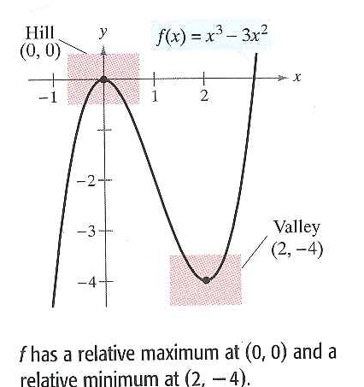
3.1 Relative Extrema and Critical Number.
Notice the endpoints or breaks in the graph cannot be relative extrema since it requires open intervals
Only hills and valleys

Slide 6
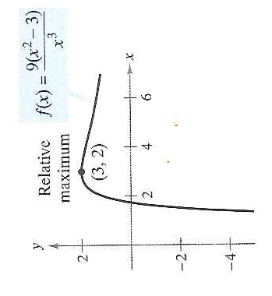
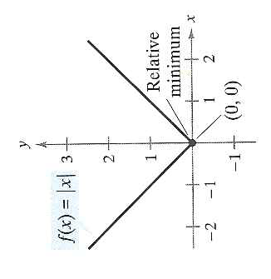
Example 1: The Value of the Derivative at Relative Extrema

Slide 7
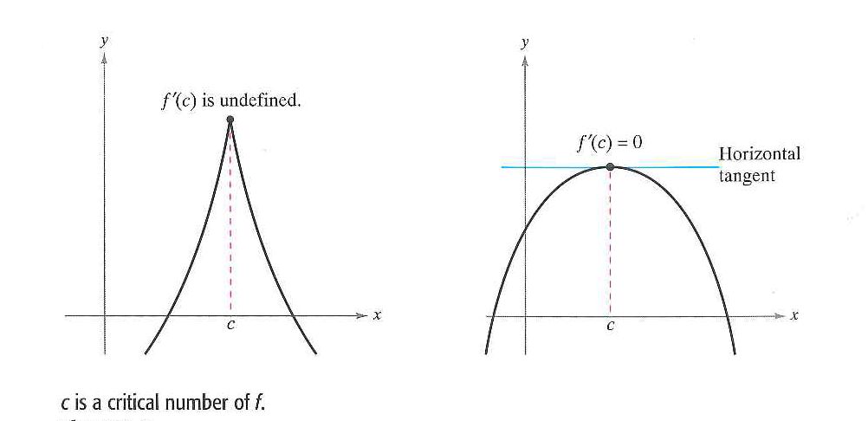
3.1 Critical Number
Be careful don’t get confused with the converse

Slide 8
3.1 Finding Extrema on a Closed Interval
Step 1 and 2 will find the highest and lowest relative extreme
Step 3 will see if the other extremas are higher than these

Slide 9
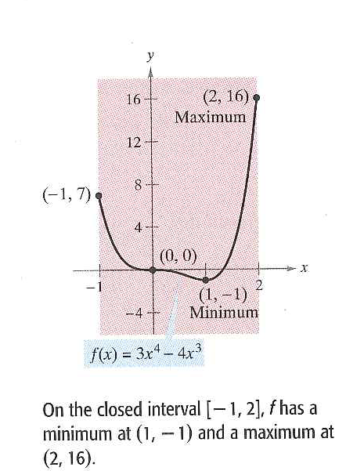
Example 2: Finding Extrema on a Closed Interval

Slide 10
Your turn

