Slide 1
9.4 Using Trig Identities
Learning Target:
We will learn to use identities to solve trigonometric equations
Review:
Memorize all new and old trig identities (many more from 9.4)
Need to remember techniques of solving trig equations from 8.4 (*factoring and knowing that even though calculator gives only one answer that there infinite answers)

Slide 2
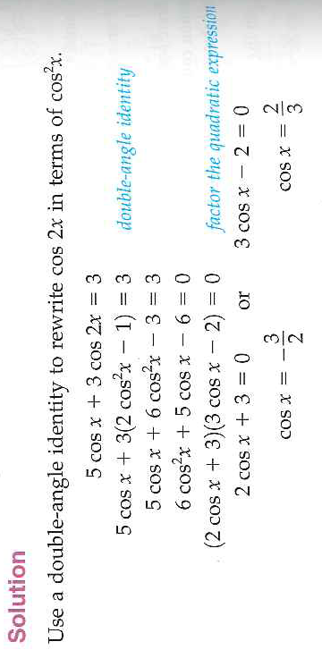
Example 1: Use Double-Angle Identities

Slide 3
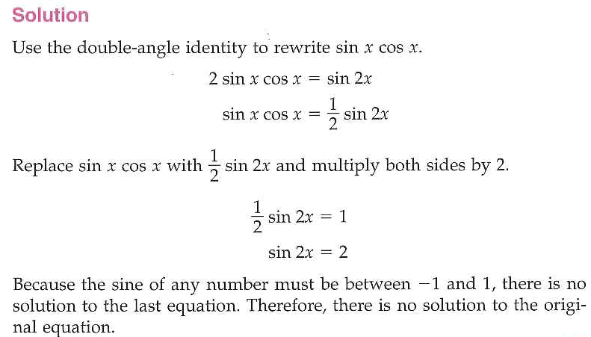
Example 2: Use Double-Angle Identities
Rearrange the identity to match the equation we are working with

Slide 4
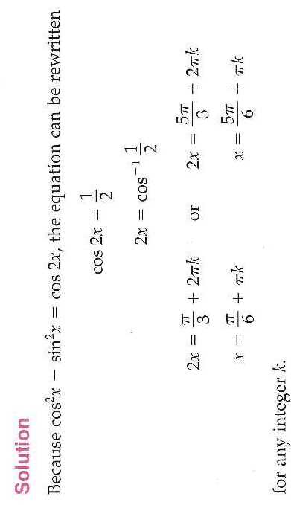
Example 3: Use Double-Angle Identities

Slide 5
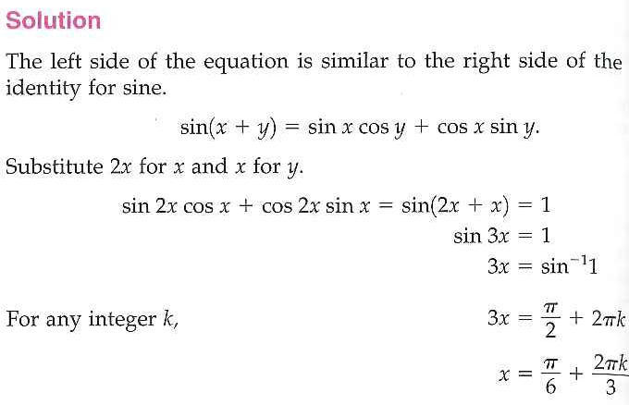
Example 4: Use Addition Identities
addition

Slide 6
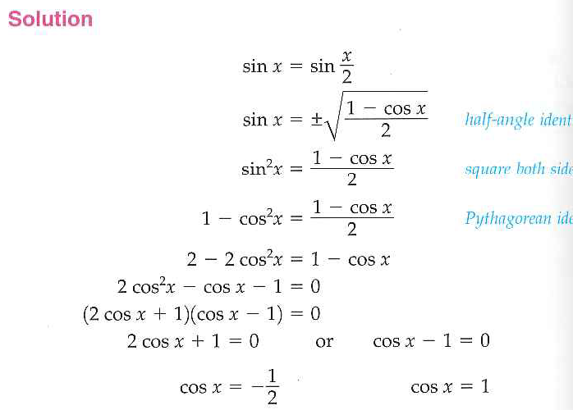
Example 5: Using Half-Angle Identities

