Slide 1
9.2 Addition and Subtraction Identities
Learning Objectives:
We will learn to use the addition and subtraction identities for sine, cosine, and tangent functions
We will learn to use the cofunction identities
Just because some operations are distributive you cannot assume others are distributive:
Above we are taking the sine of the sum of two angles.
Let’s see what happens when we do that!

Slide 2
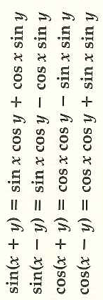
Addition and Subtraction Identities for Sine and Cosine
Example 1: Addition Identities
What does it mean by exact?
Example 2: Subtraction Identities

Slide 3
Example 3: Proving Identity Using Addition Identity

Slide 4
Example 4: Proving Difference Quotient of sin x

Slide 5
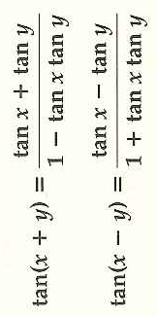
Addition and Subtraction Identities for Tangent
Think about the Quadrant

Slide 7
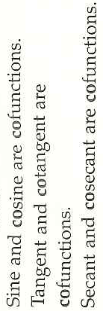
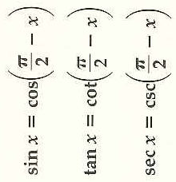
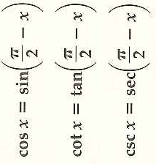
Cofunction Identities
Show that the first equation using unit circle, one x-value, and an actual proof
Show that the 2nd equation is true by using the 1st equation

Slide 8
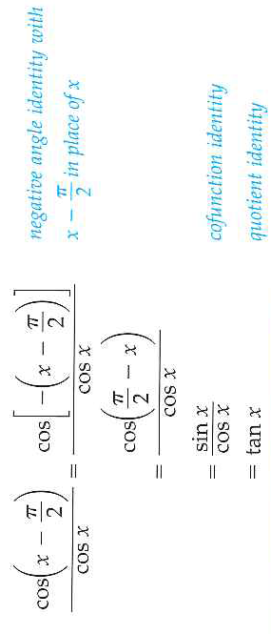
Example 6: Confunction Identities
We will use:
9.2 Hmwr: 1-23odd, 35, 36, 49-55odd, 57(prove it)

