Slide 1
9.1 Identities and Proofs
Identify possible identities by using graphs
Apply strategies to prove identities
What is the difference between an equation that is an identity and an equation that is not an identity?

Slide 2
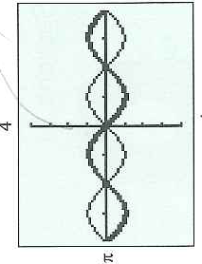
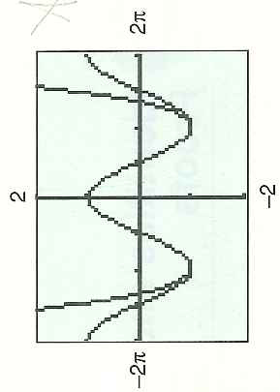
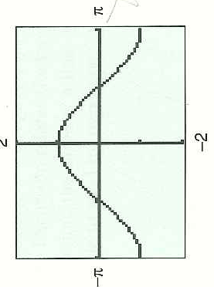
Example 1: Graphical Testing to Determine If Identity

Slide 3
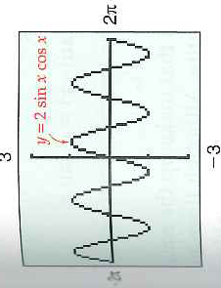
Example 2: Finding An Identity
What does this graph look like?

Slide 4
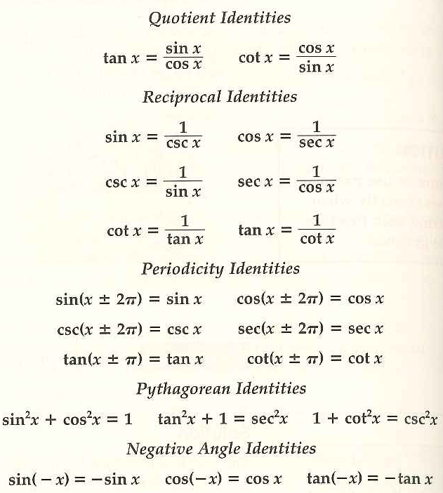
Proving New Identities By Using Old Identities: Memorize The Old Identities

Slide 5
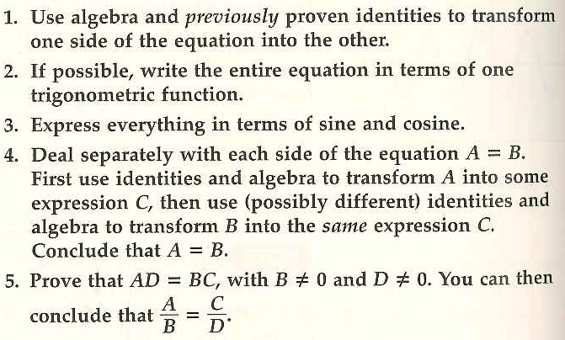
Strategies for Proving Trig Identities: Plans of Attack

Slide 6
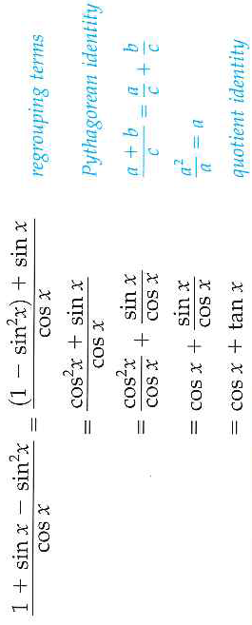
Example 3: Transform One Side Into Other Side: SG 1

Slide 7
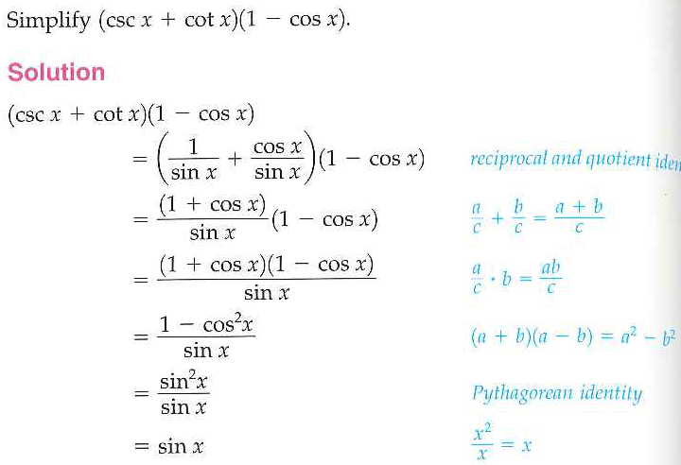
Example 4: Write Everything in Terms of Sine and Cosine: Sg 3

Slide 8
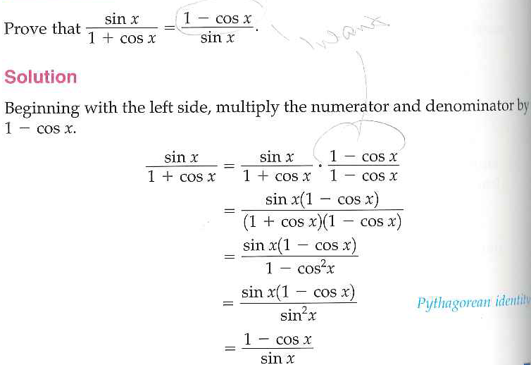
Example 5: Transform One Side Into The Other Side

Slide 9
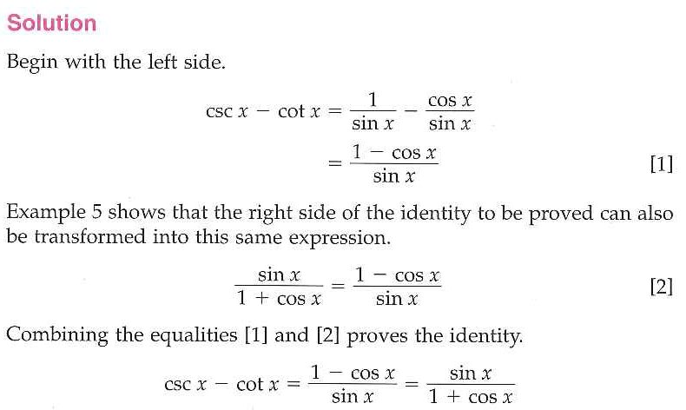
Example 6: Dealing with Each Side Separately

Slide 10
