Slide 1
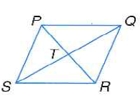
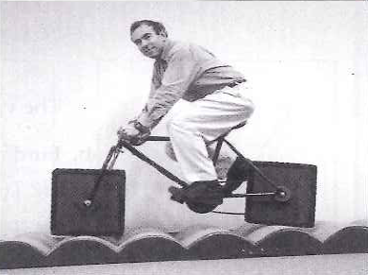
8.5 Rhombi and Squares
Learning Targets:
We will learn to recognize and apply the properties of rhombi
We will learn to recognize and apply the properties of squares

Slide 2
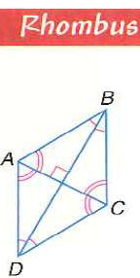
Special Properties
A rhombus is a quadrilateral with all four side congruent .
If that is true what is also true?
Extra properties:
Proof:

