Slide 1
8.4 Simple Harmonic Motion and Modeling
Learning Targets:
We will learn how to write a sinusoidal function whose graph resembles a given graph
We will learn how to write a sinusoidal function (cyclic) to represent a harmonic motion
We will learn how to find a sinusoidal model for a set of data
Why are we learning this?
With our functions we will be able to solve problems and make predictions for certain problems
ESLRs
GC, CT

Slide 2
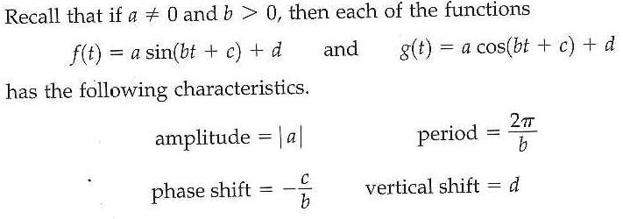
Real-World Phenomena Model by Trig Functions:

Slide 3
Example 1: Constructing Sinusoidal Functions

Slide 4
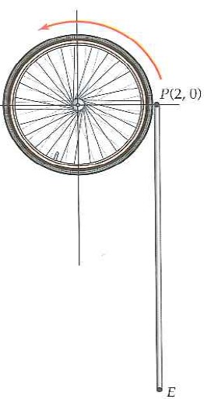
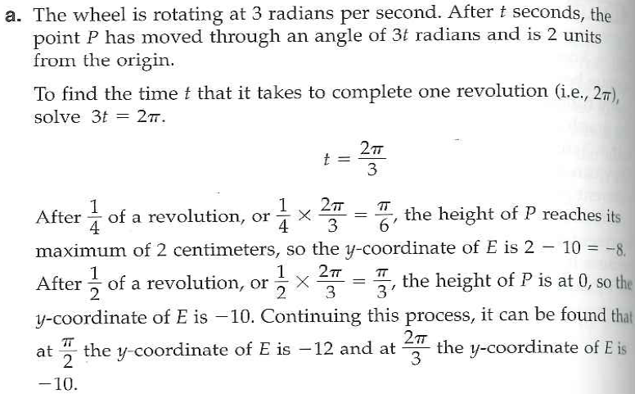
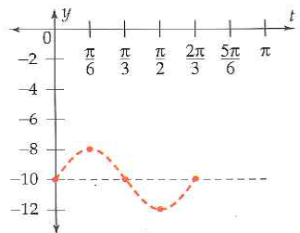

Slide 5
Example 2 con’t Part B

Slide 6
Ex 4: Modeling Trig Data: Temperature Data

Slide 7
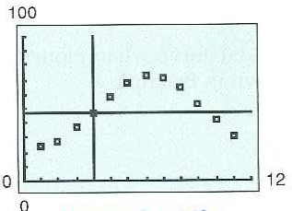
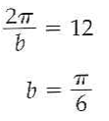
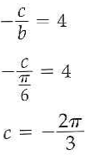

Slide 8
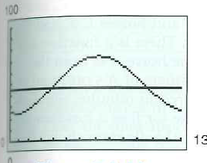
EX 4 Con’t
8.4 Hmwr 1-11odd. Next class review. Ch 8 test Thursday!

