Slide 1
8.2 Inverse Trigonometric Functions
Learning Targets:
Review Inverse functions
Learn to define the domain and range of the inverse trigonometric functions
Use inverse trigonometric function notation
Why are we learning this?
We can solve trigonometric equations using inverse trigonometric functions
How did we solve before?
Function test for y=x, y=x², y=sinx
Let us restrict the domain!

Slide 2
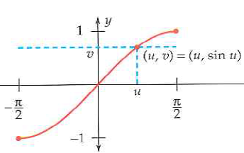
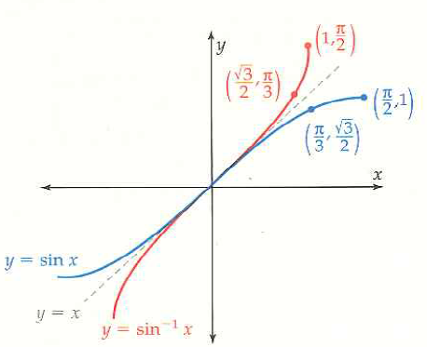
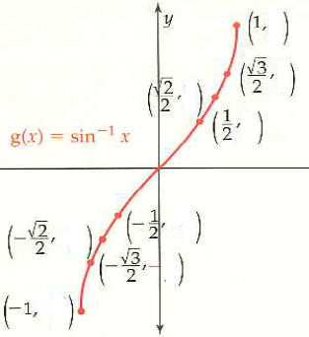
Inverse Sine Function
Now will this restricted sine function have an inverse function?
What do the input and output values of the sine and arcsine represent?

Slide 3
Inverse Sine Function
Example 1: Special Values – No Calculator
Many answers but pick the one that is in the range of sin⁻¹

Slide 4
Properties of Inverse Sine
What do these intervals represent?
Example 2: Composition of Inverse Functions
Explain not just by the rule but with logic
Sketch a cosine function and think how we can restrict the domain in order to pass the horizontal line test

Slide 5
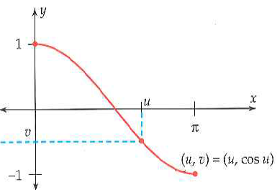
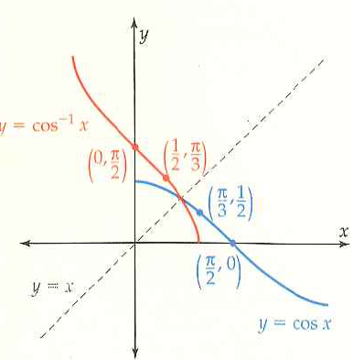
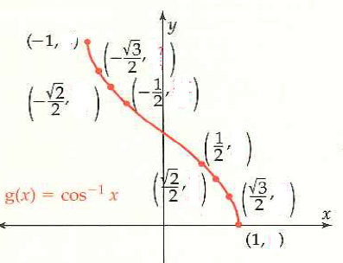
Inverse Cosine Function
Restricted cosine function:
Same definition and properties apply to the inverse cosine…Just different domain and range. Domain: Range:

Slide 6
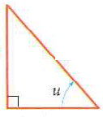
Example 4: Equivalent Algebraic Expressions
What will the value of cos⁻¹ v represent?
Fill in the missing side lengths of the triangle:

Slide 7
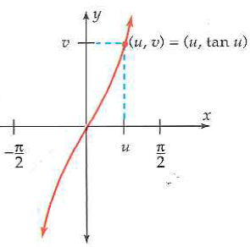
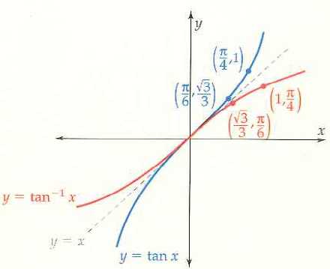
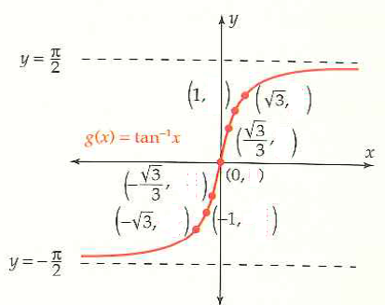
Inverse Tangent Function
Restricted tangent function:
What is the domain?
Range?
Inverse tangent function: Domain:
Range:

Slide 8
Example 5: Evaluating Inverse Tangent Expressions
Example 6: Exact Values
8.2 Hmwr:

