Slide 1
8.2 Multiplying and Dividing Rational Expressions
Objectives
Simplify rational expressions.
Multiply and divide rational expressions.
Vocabulary
rational expression
Why Learning This?
You can simplify rational expressions to determine the probability of hitting an archery target.
Warm Up
Simplify each expression.
y²
1. x⁵ • x²
2.
y⁵
Factor each expression.
5. x² – 2x – 8
6. x² – 5x
7. x⁵ – 9x³

Slide 2
A rational expression is a quotient of two polynomials.
Simplifying fractions:
Example 1A: Simplifying Rational Expressions
Simplify. Identify any x-values for which the expression is undefined.
10x⁸
x² + x – 2
16x¹¹
3x + 4
6x⁴
x² + 2x – 3
8x²
3x² + x – 4
Caution!
When identifying values for which a rational expression is undefined, identify the values of the variable that make the original denominator equal to 0.

Slide 3
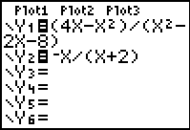
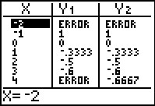
Example 2: Simplifying by Factoring by –1
Simplify. Identify x values for which the expression is undefined.
4x – x²
–x² + 3x
A.
B.
x² – 2x – 8
2x² – 7x + 3
Check The calculator screens suggest that
= except when x = – 2 or x = 4.
4x – x²
–x
x² – 2x – 8
(x + 2)

Slide 4
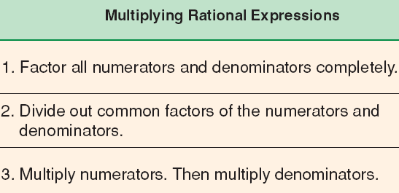
Example 3: Multiplying Rational Expressions
Multiply. Assume that all expressions are defined.
A.
3x⁵y³
10x³y⁴
B.
x – 3
x + 5
•
•
2x³y⁷
9x²y⁵
4x + 20
x² – 9

Slide 5
Recall that to divide by a fraction, you multiply by its reciprocal.
1
3
1
²
4
2
÷
=
•
=
2
4
2
3
3
Example 4A: Dividing Rational Expressions
Divide. Assume that all expressions are defined.
5x⁴
15
x⁴ – 9x²
x⁴ + 2x³ – 8x²
÷
÷
8x²y²
8y⁵
x² – 4x + 3
x² – 16

Slide 6
Example 5A: Solving Simple Rational Equations
Solve. Check your solution.
x² + x – 12
= 0
What are the solutions?
Will we have the same solutions below?
x² + x – 12
x² – 25
= 0
Factor
Divide out Common Factors
= 14
Note that x ≠ 5.
x + 4
x – 5
Check:

Slide 7
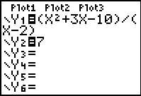
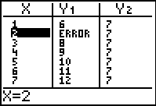
Example 5B: Solving Simple Rational Equations
Solve. Check your solution.
x² – 3x – 10
= 7
x – 2
(x + 5)(x – 2)
Note that x ≠ 2.
= 7
(x – 2)
x + 5 = 7
x = 2
Because the left side of the original equation is undefined when x = 2, there is no solution.
Check

