Slide 1
8.1 Graphical Solutions to Trigonometric Equations
We will learn:
How to solve trigonometric equations graphically and give the full solutions

Slide 2
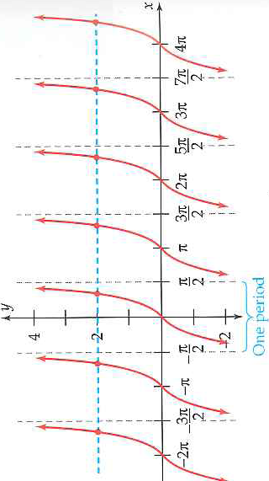
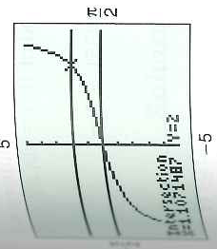
Example 1: The Intersection Method
Intersection method is to graph both sides of the equations
Determine period
Use the intersection finder on graphing calculator
Use period

Slide 3
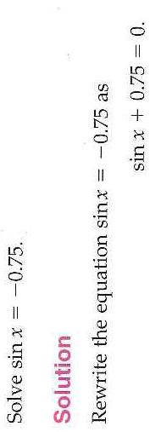
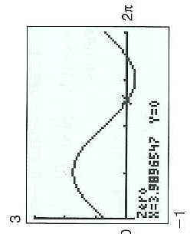
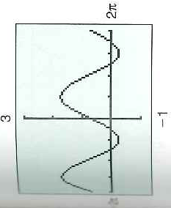
Example 2 The x-intercept Method
Determine Period

Slide 4
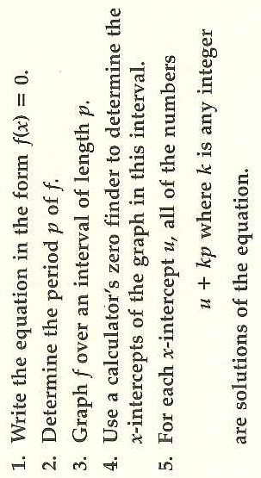
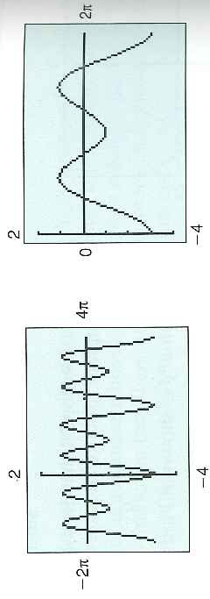
Repeat the Same Steps:

