Slide 1
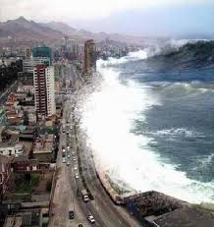
7.4 Properties of Logarithms
Objectives
Use properties to simplify logarithmic expressions.
Translate between logarithms in any base.
Why are we learning this?
Logarithmic scales are useful for measuring quantities that have a very wide range of values, such as the intensity (loudness) of a sound or the energy released by an earthquake.
Warm Up
Simplify.
1. (2⁶)(2⁸)
2. (3^{–2})(3⁵)
3.
4.
5. (7³)⁵

Slide 2
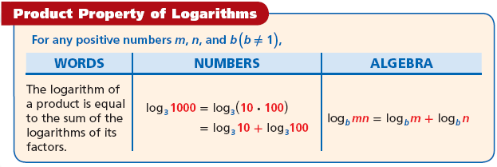
Remember that to multiply powers with the same base, you add exponents.
Check that is true using the given!:
Helpful Hint
Think: log_{j} + log_{a} + log_{m} = log_{jam}

Slide 3
Example 1: Adding Logarithms
Express log₆4 + log₆9 as a single logarithm. Simplify.
1
log₆4 + log₆9
log 27 + log
1
1
9
3
3

Slide 4
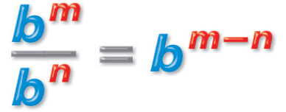
Remember that to divide powers with the same base, you subtract exponents
Check that is true using the given!:

Slide 5
Example 2: Subtracting Logarithms
Express log₅100 – log54 as a single logarithm. Simplify, if possible.
log₅100 – log54
log₇49 – log77

Slide 6
Illustrate this law with:

Slide 7
Example 3: Simplifying Logarithms with Exponents
Express as a product. Simplify, if possible.
A. log₂32⁶
b. log₅25²

Slide 8
Exponential and log operations undo each other since they are inverse operations.
Prove that these are true:

Slide 9
Example 4: Recognizing Inverses
Simplify each expression.
a. log₃3¹¹
b. log₃81
c. 5^{log510}
log₃3¹¹
5^{log510}
11
10

Slide 10
Example 5: Changing the Base of a Logarithm
Evaluate log₃₂8.
Method 1 Change to base 10
log₃₂8 =
log8
log32
0.903
≈
Use a calculator.
1.51
≈ 0.6
Divide.

