Slide 1
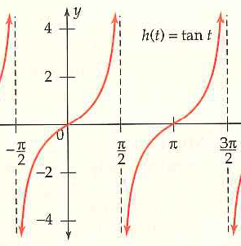
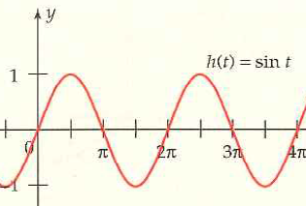
7.3 Periodic Graphs and Amplitude
A wave is the same as a cycle: a portion of a graph that shows a complete pattern
A period is a number; it is the horizontal distance required for one cycle
The amplitude is the distance of the maximum and minimum from the middle of the graph.

Slide 2
Group work Through Graphing Exploration
Complete the 2 graphing explorations on p. 494 & 496 and read example 3.
Write down the 3 corresponding rules to follow!
7.3 Hmwr: 1-17odd, 33, 36, 39, 41, 43, 51, 53, 57, 65

