Slide 1
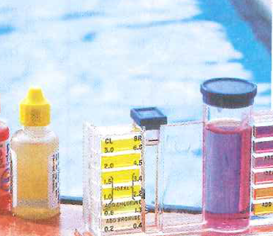
7.3 Logarithmic Functions
Objectives
Write equivalent forms for exponential and logarithmic functions.
Write, evaluate, and graph logarithmic functions.
Vocabulary
logarithm
common logarithm
logarithmic function
Why are we Learning this?
A logarithmic scale is used to measure the acidity, or pH, of water

Slide 3
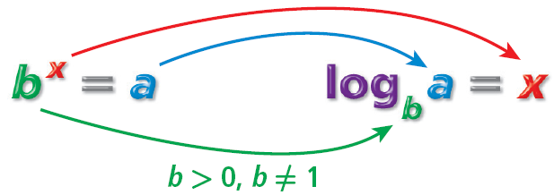
What Is A Log?
How many times would you have to double $1 before you had $8?
How many times would you have to double $1 before you had $512? 2^{x} = 512
The inverse operation that undoes raising a base to an exponent is called finding the logarithm.
A logarithm is the exponent to which a specified base is raised to obtain a given value.
Reading Math
log_{b} a= x: “the log base b of a is x.” Notice that the log is the exponent.
A log with base 10 is called a common logarithm. If no base is written for a log, the base is assumed to be 10. For ex, log 5 = log₁₀5.

Slide 4
Example 1: Converting from Exponential to Logarithmic Form
Write each exponential equation in logarithmic form.
Exponential Equation | Logarithmic Form
3⁵ = 243
25 = 5
10⁴ = 10,000
6^{–1} =
a^{b} = c
log₃243 = 5
The base of the exponent becomes the base of the logarithm.
1
1
2
log₂₅5 =
The exponent is the logarithm.
2
1
An exponent (or log) can be negative.
6
The log (and the exponent) can be a variable.

Slide 5
Example 2: Converting from Logarithmic to Exponential Form
Write each logarithmic form in exponential equation.
Logarithmic Form | Exponential Equation
log₉9 = 1
log₂512 = 9
log₈2 =
log₄ = –2
log_{b}1 = 0
The base of the logarithm becomes the base of the power.
9¹ = 9
2⁹ = 512
The logarithm is the exponent.
1
1
8 = 2
3
3
1
A logarithm can be a negative number.
16
Any nonzero base to the zero power is 1.

Slide 6
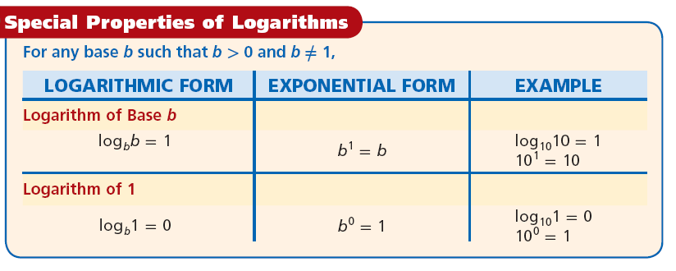
Evaluate by converting to an exponential statement:
Log₁₀10=
Log₁₇1=
A logarithm is an exponent, so the rules for exponents also apply to logs.

Slide 7
Example 3A: Evaluating Logarithms by Using Mental Math
Evaluate by using mental math.
log 0.01
log₅ 125
The log is the exponent.
10? = 0.01
Think: What power of 10 is 0.01?
10⁻² = 0.01
Go back to the log expression:
log 0.01 = –2
1
log₅
5

Slide 8
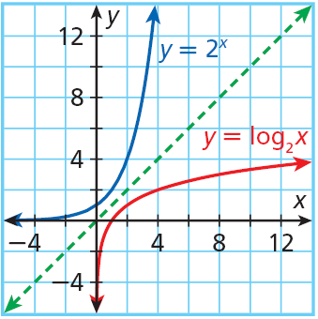
Because logarithms are the inverses of exponents, the inverse of an exponential function, such as y = 2^{x}, is a logarithmic function, such as y = log₂x.
You may notice that the domain and range of each function are switched.
Domain
Range

Slide 9
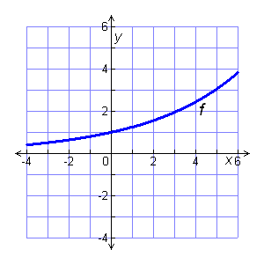
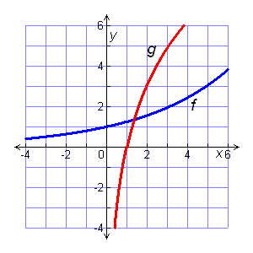
Example 4A: Graphing Logarithmic Functions
Use the x-values {–2, –1, 0, 1, 2}. Graph the function and its inverse. Describe the domain and range of the inverse function.
f(x) = 1.25^{x}
Graph f(x) = 1.25^{x} by using a table of values.
x
–2
–1
0
1
2
f(x) = 1.25^{x}
0.64
0.8
1
1.25
1.5625
To graph the inverse, f^{–1}(x) = log_{1.25}x, by using a table of values.
x
0.64
0.8
1
1.25
1.5625
f^{–1}(x) = log_{1.25}x
–2
–1
0
1
2

