Slide 1
7.2 Graphs of the Cosecant, Secant, and Cotangent Functions
Learning Goals:
Graphs of the Cosecant, Secant, and Cotangent Functions
Graph transformations
When you think about the csc, sec, and cot graphs what do you think about?

Slide 2
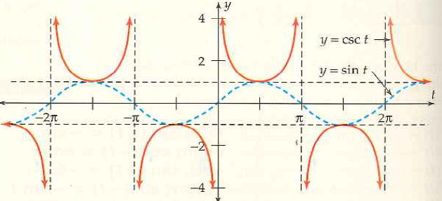
Graph of the Cosecant Function
How are these graphs similar? How are they different?
How to understand the relationship?
Domain and Range?

Slide 3
Example 1: Reflection and Vertical
Different ways of performing transformations but remember we always pick important points and perform transformation on them. Then connect new points for new graph

Slide 4
Graph of the Secant Function
Visulize the cosine graph. When is it zero?
What does that tell you about the sec graph?
Domain and Range?
Period (how long until it repeats itself?
Compare and Contrast:

Slide 5
Example 2: Vertical Stretch and Vertical Shift

Slide 6
Graph of the Cotangent Function
Compare and Contrast. Explain
Domain and Range. Explain
Period

Slide 7
Example 3: Reflection, Vertical Stretch, and Horizontal Shift

Slide 8
Even and Odd Function Definition:
7.2 Hmwr:5-13odd, 18-25, 35, 37, 39

