Slide 1
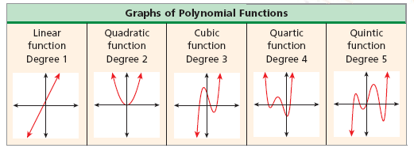
Preview to 6.7: Graphs of Polynomial

Slide 2
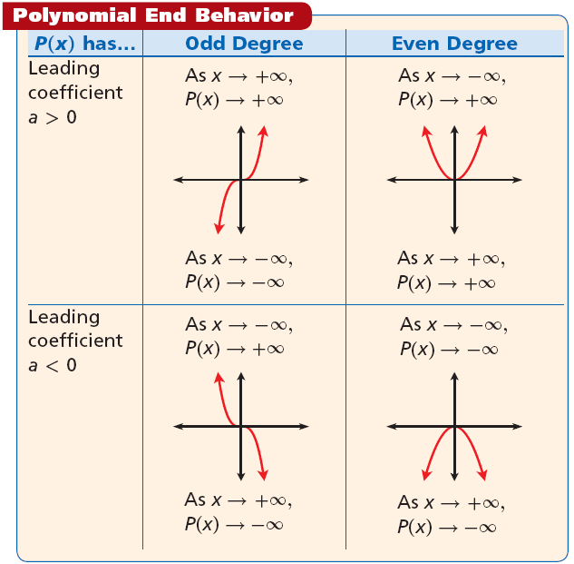

Slide 3
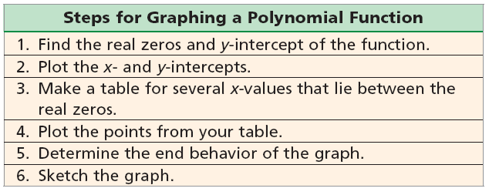
Finishing 6.7: Graphing Polynomials
How do we find x and y –intercepts?

Slide 4
Check It Out! Example 3a
Graph the function. f(x) = x³ – 2x² – 5x + 6.
Step 1 Identify the possible rational roots by using the Rational Root Theorem.
±1, ±2, ±3, ±6
p = 6, and q = 1.
Step 2 Test all possible rational zeros until a zero is identified.
Test x = –1.
Test x = 1.
–1
1 –2 –5 6
1
1 –2 –5 6
–1
3
2
1
–1
–6
1
–3
–2
8
1
–1
–6
0
x = 1 is a zero, and f(x) = (x – 1)(x² – x – 6).

Slide 5
Check It Out! Example 3a Continued
Step 3 Write the equation in factored form.
Factor: f(x) = (x – 1)(x + 2)(x – 3)
The zeros are 1, –2, and 3.
Step 4 Plot other points as guidelines. y-intercept
f(–1) = 8, and f(2) = –4.

Slide 6
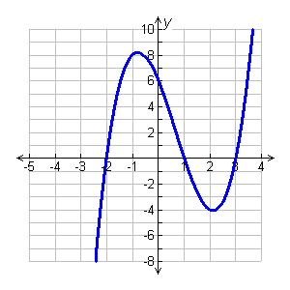
Check It Out! Example 3a Continued
Step 5 Identify end behavior.
The degree is odd and the leading coefficient is positive so as
x –∞, P(x) –∞, and as x +∞, P(x) +∞.
Step 6 Sketch the graph of f(x) = x³ – 2x² – 5x + 6 by using all of the information about f(x).
In your textbook 6.7 complete questions 10, 11, 23, 24, 25, 26
**Check answers in the back of the book!!

