Slide 1
Review & 6.6 The Fundamental Theorem of Algebra
Reviewing:
Equivalent statements
Multiplicities
Rational Root Theorem
Irrational Root Theorem
Introducing:
Fundamental Theorem of Algebra and it’s corollary (very intuitive)
Complex Conjugate Root Theorem
Demonstrating:
Factoring polynomials with the help of a graphing calculator
Analyzing answer and graph afterwards
Performing:
6.5 Practice B questions 5 - 9, 6.6 Practice B questions 5 - 9
List all different factoring methods as a review of 6.4/6.5/6.6 for Monday’s Quiz

Slide 2
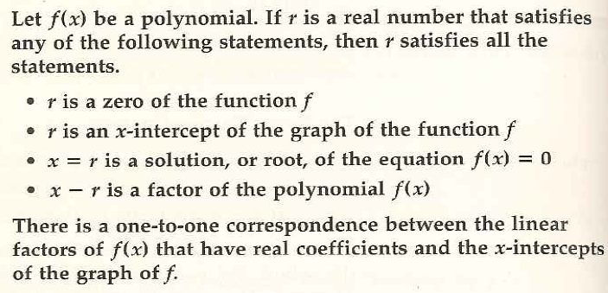
Zeros, x-Intercepts, Solutions (Roots), and Factors of Polynomials

Slide 3
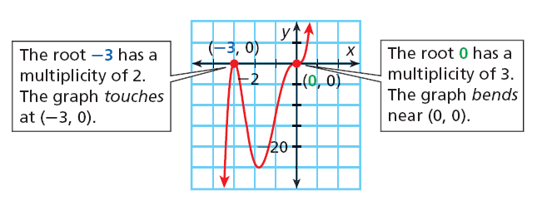
Multiplicity(the exponent of the Factor): For Even Multiplicity the Graph only Touches At the X-Intercept For Odd Multiplicity the Graph Crosses at the X-Intercept

Slide 4
Rational Root Theorem: Constant Term and the Leading Coefficient
P(x) = 2x³ – 6x² + 12x - 8

Slide 5
P(x) = x² – 3
Complex Conjugate Root Theorem
If a+bi is a root of a polynomial equation with real-number coefficients, then a-bi is also a root
P(x) = x² – 2x + 2

Slide 6
How many factors should this polynomial expression have?
P(x) = x⁴ + x³ + 2x² + 4x – 8

