Slide 1
6.5 Basic Trigonometric Identities
We are we learning this?
Identities simplify complicated formulas used in physics, engineering, etc (making our life much easier)

Slide 2
Basic Trig Notation

Slide 3
Identities: What are Identities?
Quotient Identities
Example 1:

Slide 4
Example 2: Reciprocal Identities

Slide 5
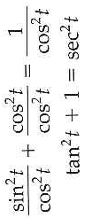
Pythagorean Identities
Example 3: Pythagorean Identities

Slide 6
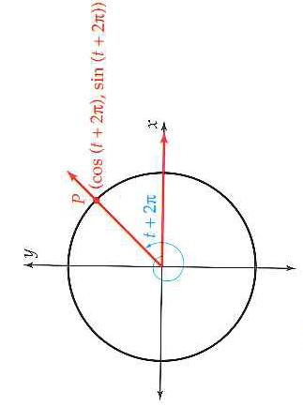
Periodicity Identities

Slide 7
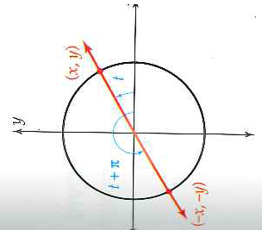
Periodicity Identities

Slide 8
Example 4: Periodicity Identities

Slide 9
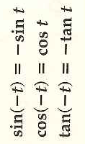
Negative Angle Identities
Example 5: Negative Angle Identities

Slide 10
Identities Involving -t
Example 6: Identities Involving -t

Slide 11
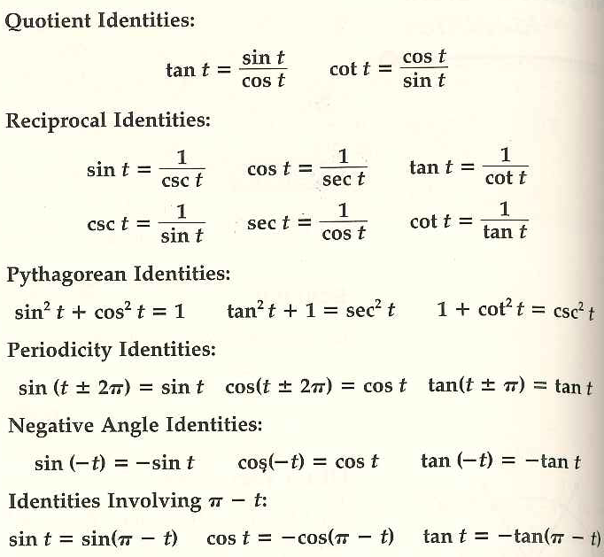

Slide 12
6.5 Hmwr: pg. 461: 1-9odd, 15-23odd, 33-37odd, 51,53, 55.

