Slide 1
6.5 Solving Linear Inequalities 6.6 Solving Systems of Inequalities

Slide 2
Example 2A: Graphing Linear Inequalities in Two Variables
Graph the solutions of the linear inequality.
y ≤ 2x – 3
Check

Slide 3
Graphing Linear Inequalities
Step 1
Solve the inequality for y (slope-intercept form).
Graph the boundary line. Use a solid line for ≤ or ≥. Use a dashed line for < or >.
Step 2
Shade the half-plane above the line for y > or ≥. Shade the half-plane below the line for y < or y ≤. Check your answer.
Step 3

Slide 4
Example 2B: Graphing Linear Inequalities in Two Variables
Graph the solutions of the linear inequality.
5x + 2y > –8

Slide 5
Example 2C: Graphing Linear Inequalities in two Variables
Graph the solutions of the linear inequality.
4x – y + 2 ≤ 0

Slide 6
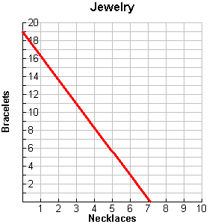
Example 3a: Application
Ada has at most 285 beads to make jewelry. A necklace requires 40 beads, and a bracelet requires 15 beads.
Write a linear inequality to describe the situation and then graph.
Give two combinations of necklaces and bracelets that Ada could make.

Slide 7
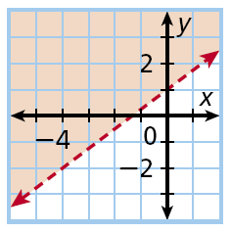
Example 4A: Writing an Inequality from a Graph
Write an inequality to represent the graph.

Slide 8
6.6 Solving System of Inequalities
Example 2A: Solving a System of Linear Inequalities by Graphing
Graph the system of linear inequalities. Give two ordered pairs that are solutions and two that are not solutions.
y ≤ 3
y > –x + 5

Slide 9
Example 2B: Solving a System of Linear Inequalities by Graphing
Graph the system of linear inequalities. Give two ordered pairs that are solutions and two that are not solutions.
–3x + 2y ≥ 2
y < 4x + 3

Slide 10
In Lesson 6-4, you saw that in systems of linear equations, if the lines are parallel, there are no solutions. With systems of linear inequalities, that is not always true.

Slide 11
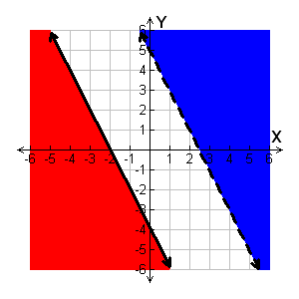
In Lesson 6-4, you saw that in systems of linear equations, if the lines are parallel, there are no solutions. With systems of linear inequalities, that is not always true.
Example 3A: Graphing Systems with Parallel Boundary Lines
Graph the system of linear inequalities.
y ≤ –2x – 4
y > –2x + 5
This system has no solutions.

Slide 12
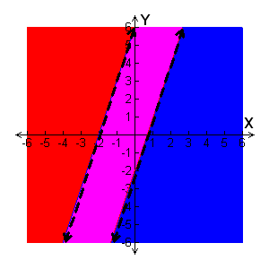
Example 3B: Graphing Systems with Parallel Boundary Lines
Graph the system of linear inequalities.
y > 3x – 2
y < 3x + 6
The solutions are all points between the parallel lines but not on the dashed lines.

Slide 13
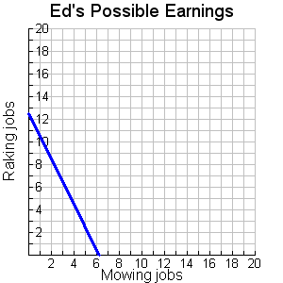
Example 4: Application
In one week, Ed can mow at most 9 times and rake at most 7 times. He charges $20 for mowing and $10 for raking. He needs to make more than $125 in one week. Show and describe all the possible combinations of mowing and raking that Ed can do to meet his goal. List two possible combinations.
Solutions

