Slide 1
6.5 Finding Real Roots of Polynomial Equations
Objectives
Identify the multiplicity of roots.
Use the Rational Root Theorem and the irrational Root Theorem to solve polynomial equations.
Vocabulary
multiplicity
Why are we learning this? Connection to Marketing!
The design of a box specifies that its length is 4 inches greater than its width. The height is 1 inch less than the width. The volume of the box is 12 cubic inches. What is the width of the box?

Slide 2
Review Factoring Techniques
Factor completely.
1. 2y³ + 4y² – 30y
2. 3x⁴ – 6x² – 24
3. x² – 9
4. x³ + 3x² – 4x

Slide 3
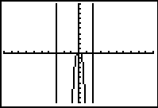
Example 1A: Using Factoring to Solve Polynomial Equations
Solve the polynomial equation.
4x⁶ + 4x⁵ – 24x⁴ = 0
x⁴ + 25 = 26x²
Check Use a graph. The roots appear to be located at x = 0, x = –3, and x = 2. ✓

Slide 4
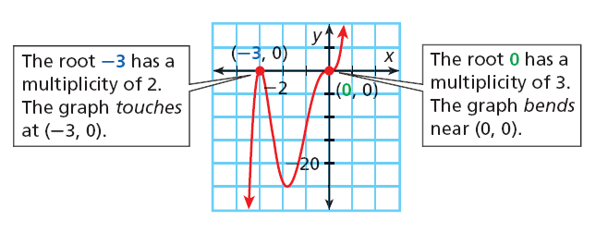
Sometimes a polynomial equation has a factor that appears more than once. This creates a multiple root. The equation 3x⁵ + 18x⁴ + 27x³ = 0 has two multiple roots, 0 and –3.
The multiplicity of root r is the number of times that x – r is a factor of P(x). When a root has even multiplicity, the graph of y = P(x) touches the x-axis but does not cross it. When a root has odd multiplicity , the graph crosses the x-axis. When a root has odd multiplicity greater than 1, the graph bends as it crosses the x-axis

Slide 5
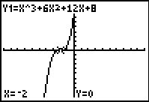
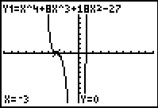
Example 2A: Identifying Multiplicity
Identify the roots of each equation. State the multiplicity of each root.
x³ + 6x² + 12x + 8 = 0
x⁴ + 8x³ + 18x² – 27 = 0
Check The graph crosses and bends near (–2, 0). ✓
Check The graph shows a bend near (–3, 0) and crosses at (1, 0). ✓

Slide 6
Sometimes the techniques we have learnt for factoring so far won’t work for all polynomials.
The next technique we can use is the:
Polynomial equations may also have irrational roots.

Slide 7
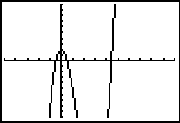
Example 4: Identifying All of the Real Roots of a Polynomial Equation
Identify all the real roots of 2x³ – 9x² + 2 = 0.

Slide 8
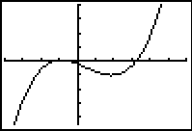
Check It Out! Example 4
Identify all the real roots of 2x³ – 3x² –10x – 4 = 0.

