Slide 1
6.4 Trigonometric Functions Notes
See Examples in Textbook

Slide 2
Extending the Trig Ratios And Function Language

Slide 3
Making the Definition of Trig Ratios Easier: When the Point of the Angle is on the Unit Circle
Verbalize it! What is the cos t:
What is sin t:

Slide 4
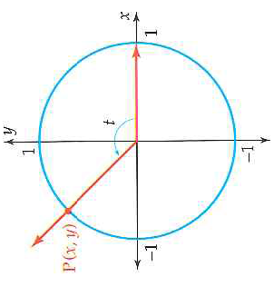
Domain and Range
Why?

Slide 5
Questions to Check Understand

Slide 6
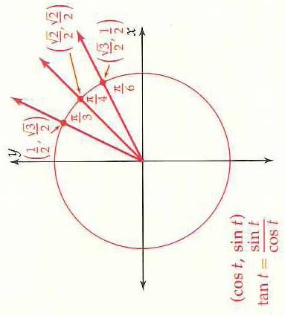
Signs of the Trigonometric Functions

Slide 7
More Exact Values of Trig Functions: Visualize the Angle on the Coordinate Plane

Slide 9
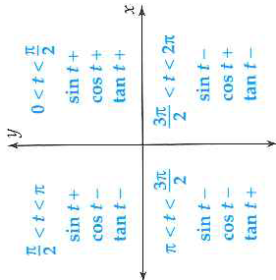
Example: Using Reference Angles

Slide 10
Hmwr: make a table like below for sin and cos from 0 all the way to 2. graph the points on Graph Paper. Read Pg. 474/476 and write down in a couple of sentences what you learned
t | 0 | /6 | ..... |  |  |  | ... |  | 2
sin t
t | 0 | /6 | ..... |  |  |  | ... |  | 2
cos t

