Slide 1
6.3 Angles and Radian Measure
Learning Goals:
Learn to use a rotating ray to extend the definition of angle measure to negative angles and angles greater than 180
Define radian measure and convert angle measure between degrees and radians

Slide 2
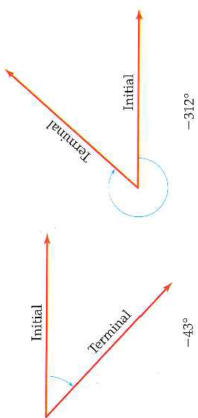
Extending Angle Measure
When looking at an angle you need to visual a rotating ray.
The amount the ray is rotated is the measure of the angle.
Counter clockwise rotations have positive measures and clockwise rotations have negative measures.

Slide 3
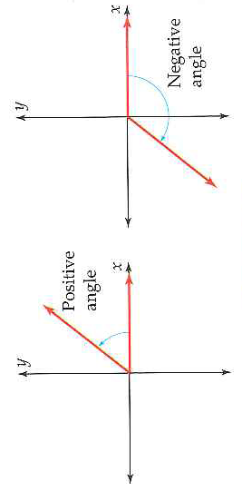
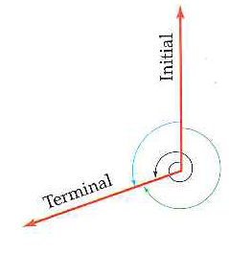
Standard Position and Coterminal Angles
An angle in the coordinate plane is said to be in standard position if its vertex is at the origin and its initial side is on the positive x-axis
Angles formed by different rotations that have the same initial and terminal sides are called coterminal

Slide 4
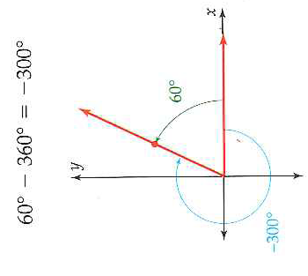
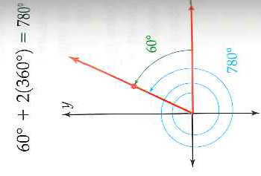
Example 1: Coterminal Angles
Find three angles conterminal with an angle of 60º in standard position

Slide 5
Arc Length
An arc is a part of a circle
A central angle is an angle whose vertex is the center of the circle
The length of an arc depends on the radius of the circle and the measure of the central angle that the arc intercepts
The length l of an arc is given by the formula:
Does this formula make sense?

Slide 6
Example 2: Finding an Angle Given an Arc Length

Slide 7
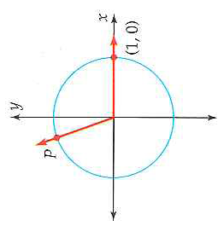
Radian Measure: A Way to describe Angle Measure by using arc length
Radian measure is another unit measure for angles that simplify many formulas in calculus and physics
What units were we using before to describe angles?
Radian measure of an angle can be thought of as the arc length intercepted by a central angle when the radius of the circle is 1
So take your angle and make it an central angle for a circle with radius 1.
How?

Slide 8
Definition of Radian Measure
How did they get this formula?

Slide 9
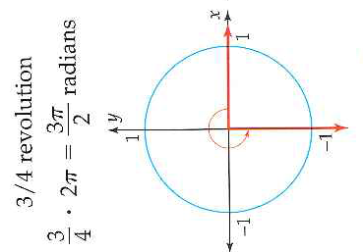
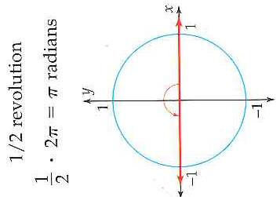
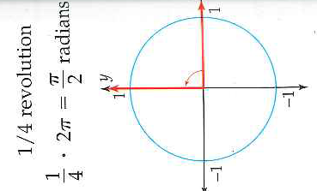
Radian Measure: Fraction of the Total Circumference
What are the degree of these angles?
Conclude: Acute/Obtuse

Slide 10
Radian Measure of Special Angles

Slide 11
Converting Between Degrees and Radians

Slide 12
Example 4: Converting from degrees to Radians

Slide 13
6.3 Hmwr: p. 441: 1-9odd, 11, 15, 19, 23, 27, 31, 43, 44, 47

