Slide 1
6.2 Trigonometric Applications
ESLRs
Learning Targets:
learn how to solve triangles using trig ratios
learn how to solve applications using triangles

Slide 2
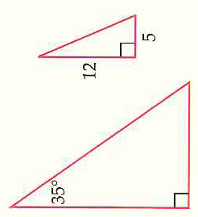
Solving Right Triangles
Solving a triangle means finding the lengths of all three sides and the measures of all three angles

Slide 3
Example 1: Finding a Side of a Triangle
How could you check your work?

Slide 4
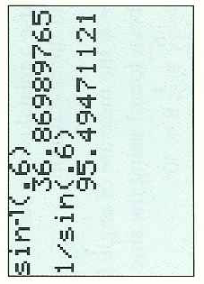
Example 2: Finding an Angle of a Triangle
Since all three sides are known how many methods are there to find θ?
Find the third angle, call it α, and notice that:

Slide 5
Summary for Solving Right Triangles

Slide 6
Example 3: Case 1: Solving a Right Triangle

Slide 7
Example 4: Case 2: Solving a Right Triangle

Slide 8
Angles of Elevation and Depression
Angle of elevation of the top of lighthouse from the boat:
How much do I have to elevate my eyes to see the top of the lighthouse.... that is the angle of elevation!
Likewise for the angle of depression of the boat from the top of the lighthouse
How much do I have to lower, depress, my eyes to see the boat?

Slide 9
Example 8: Indirect Measurement

Slide 10
Example 9: Indirect Measurement

Slide 11
6.2 Hmwr: 1,3,7,9,13,17,25,37,39,43,45,49

