Slide 1
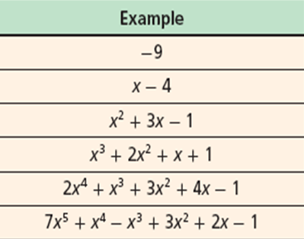
Review 6.1: Things to Memorize!
Naming by Degree |  | Naming by Number of Terms
Degree | Name | Number of Terms | Name
0 | Constant | 1 | Monomial
1 | Linear | 2 | Binomial
2 | Quadratic | 3 | Trinomial
3 | Cubic | Many (4 or more) | Polynomial
4 | Quartic
5 | Quintic

Slide 2
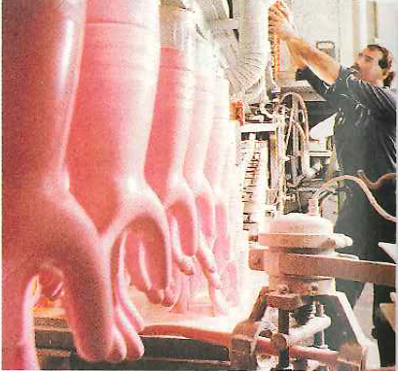
6.2 Multiplying Polynomials
Learning Goals
Multiply polynomials.
Use binomial expansion to expand binomial expressions that are raised to positive integer powers.
Why Learn This?
Business managers can multiply polynomials when modeling total manufacturing cost
Warm Up
Multiply.
1. x(x³)
2. 3x²(x⁵)
3. 2(5x³)
4. x(6x²)
5. xy(7x²)
6. 3y²(–3y)

Slide 3
Distribute and remember your exponent laws:
Example 1: Multiplying a Monomial and a Polynomial
Find each product.
A. 4y²(y² + 3)
B. fg(f⁴ + 2f³g – 3f²g² + fg³)
C. 3cd²(4c²d – 6cd + 14cd²)

Slide 4
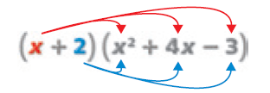
Example 2A: Multiplying Polynomials
Find the product.
Find the product.
(a – 3)(2 – 5a + a²)
(y² – 7y + 5)(y² – y – 3)
y² –y –3
y²
y⁴ | –y³ | –3y²
–7y³ | 7y² | 21y
5y² | –5y | –15
–7y
5
y⁴ – 8y³ + 9y² + 16y – 15

Slide 5
Check It Out! Example 3
Mr. Nat manages a manufacturing plant. From 1990 through 2005 the number of sunglasses produced (in thousands) can be modeled by N(x) = 0.02x² + 0.2x + 3. The average cost per unit (in dollars) can be modeled by C(x) = –0.004x² – 0.1x + 3. Write a polynomial T(x) that can be used to model the total costs.

Slide 6
Example 4: Expanding a Power of a Binomial
Find the product.
(a + 2b)³

Slide 7
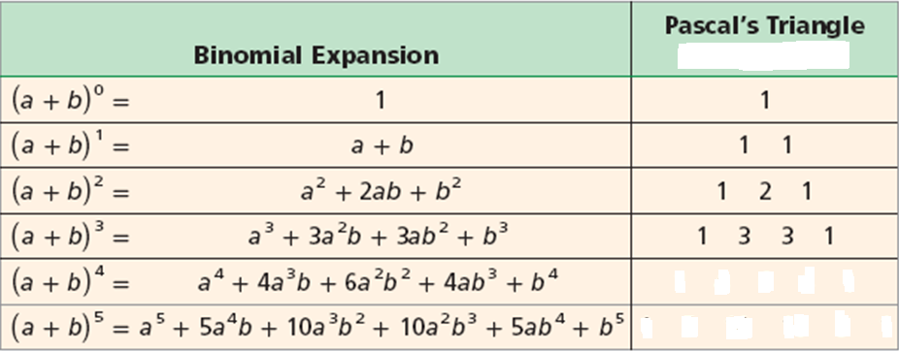
The Most Beautiful Triangle: Pascal’s Triangle! Making Life Simple
Do you see the pattern in Pascal’s Triangle? Continue it!
What do you notice about the binomial expansion and Pascal's triangle??
Do you notice anything about the exponents of the binomial expansion???

Slide 8
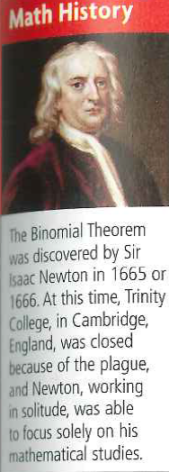
Ex5: Using Pascal’s Triangle to Expand Binomial Expressions
Expand each expression.
A. (k – 5)³
B. (3x + 1)⁴

