Slide 1
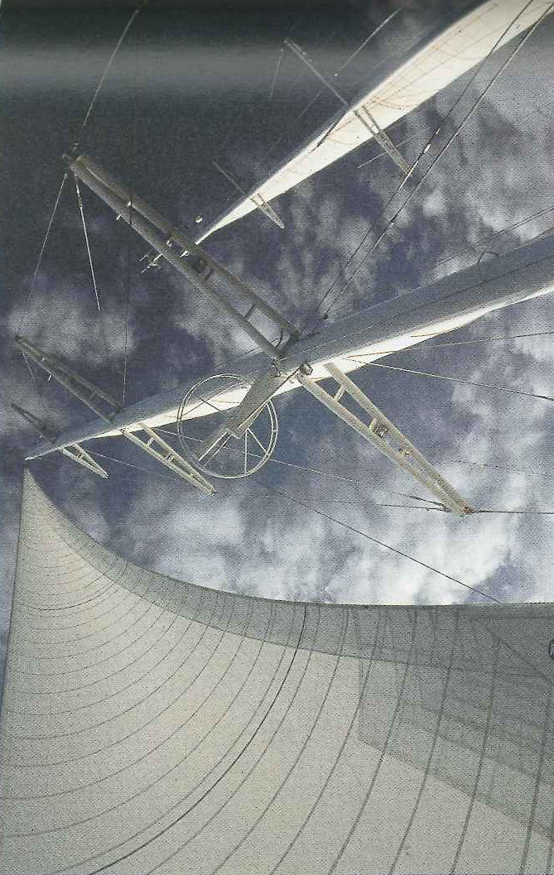
Chapter 6: Trigonometry
6.1 Right-Triangle Trigonometry

Slide 2
Trigonometry: Triangle Measurements
Developed in ancient time for determining the angles and sides of triangles in order to solve problems in astronomy, navigation, and surveying.
Development of calculus and physics takes trig to a whole different level
Now we can model all kinds of periodic behaviour, such as sounds waves, vibrations, and planetary orbits
We have solved problems before using triangle measurements and periodic behaviour.
Examples:
Today we will look at Right-Triangle Trigonometry

Slide 3
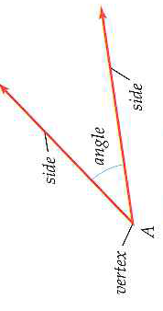
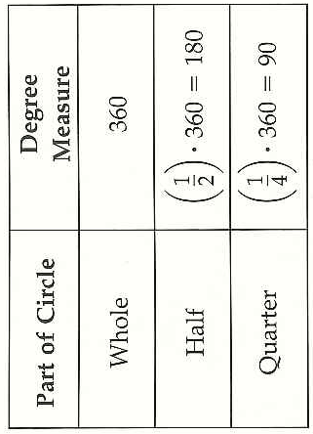
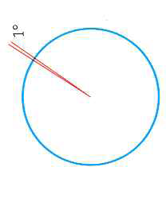
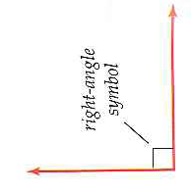
Angles and Degree Measure
Angles may be measured in:
1 degree (º) is 1/360 of a circle
Thus, a 360º angles is an entire circle, a 180º angles is half a circle, and a 90º angle is a:

Slide 4
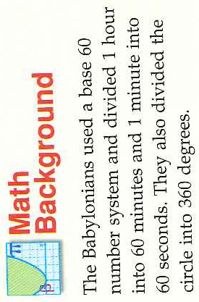
Degree written in DMS Form: Degrees, Minutes, Seconds
A minute (´) is 1/60 of a degree, and a second (´´) is 1/60 of a minute, or ______ of a degree
Example 1: Converting Between Decimal Form and DMS Form

Slide 5
Similar Triangles and Trigonometric Ratios

Slide 6
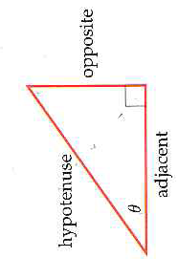
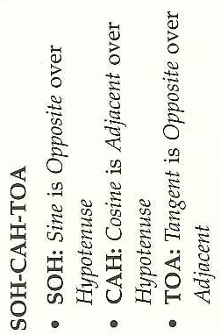
Trigonometric Ratios

Slide 7
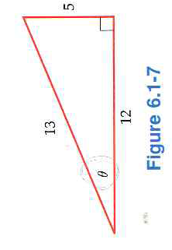
Example 2: Evaluating Trigonometric Ratios
Q:Why is this information good to know?

Slide 8
Example 3: Evaluating Trigonometric Ratios

Slide 9
Example 4: Evaluating Trigonometric Ratios on a Calculator

Slide 10
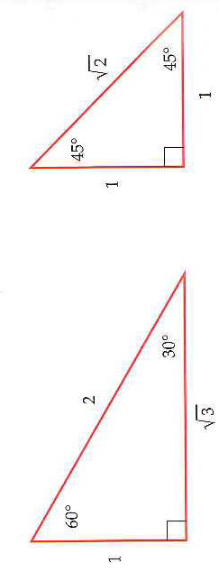
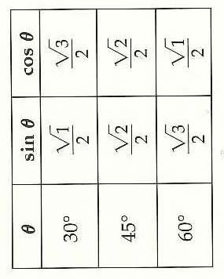
Special Angles:
Example 5: Evaluating Trig Ratios of Special Angles
Memorize!

Slide 11
6.1 Hmwr: p. 419: 1-9odd, 13-25odd, 27,28,35,39, 41,43,45

