Slide 1
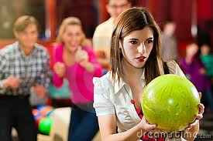
6.1 Solving Systems by Graphing
Learning Goals
Identify solutions of linear equations in two variables.
Solve systems of linear equations in two variables by graphing.
Vocabulary
systems of linear equations
solution of a system of linear equations
Why are we learning this?
You can compare cost by graphing a system of equations
Warm Up
Evaluate each expression for x = 1 and y = –3.
x – 4y
Write each expression in slope-intercept form.
2. 0 = 5y + 5x

Slide 2
A system of linear equations is a set of two linear equations. A solution of a system of linear equations is an ordered pair (x, y), that make both equations true.
Example 1A: Identifying Systems of Solutions
Tell whether the ordered pair is a solution of the given system.
(5, 2);
3x – y = 13
Helpful Hint
If an ordered pair does not satisfy the first equation in the system, there is no reason to check the other equations.

Slide 3
Example 1B: Identifying Systems of Solutions
Tell whether the ordered pair is a solution of the given system.
x + 3y = 4
(–2, 2);
–x + y = 2
(-2, 2) is a solution to what?

Slide 4
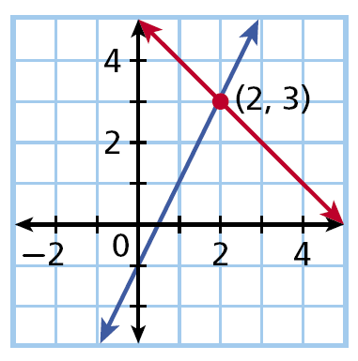
All solutions of a linear equation are on its graph. So how do we find the solution of a system of linear equations.
y = 2x – 1
y = –x + 5
Helpful Hint
Sometimes it is difficult to tell exactly where the lines cross when you solve by graphing (make sure to use a ruler!). It is good to confirm your answer by substituting it into both equations.

Slide 5
Example 2A: Solving a System Equations by Graphing
Solve the system by graphing. Check your answer.
y = x
y = –2x – 3
Graph the system.
Check:
y = x
y = –2x – 3

Slide 6
Check It Out! Example 2a
Solve the system by graphing. Check your answer.
y = –2x – 1
y = x + 5

Slide 7
Example 3: Problem-Solving Application
You and your friends want to go bowling. You don’t know how many games you will play yet but you want to compare costs. Bowl-o-Rama charges $2.50 per game plus $2 for shoe rental and Bowling Pinz charges $2 per game plus $4 for shoe rental. Which bowling place is better?

Slide 8
Example 3: Problem-Solving Application
Wren and Jenny are reading the same book. Wren is on page 14 and reads 2 pages every night. Jenny is on page 6 and reads 3 pages every night. After how many nights will they have read the same number of pages? How many pages will that be?
Total
pages
number read
every
night
already read.
is
plus
Wren
y
=
2
• x
+
14
Jenni
y
=
3
• x
+
6
As seen from these 2 application questions, there can be many different real-world example. When you are done Practice B, create your example with a solution. Include a picture or diagram to help others visualize the problem

