Slide 1
Ch 5: Linear Functions 1st Lesson: 3 Way to Graph Linear Equations
Objectives:
Understand what a linear function is.
Graph a linear function using a table value for two points.
Graph a linear function by finding the x- and y-intercepts.
Graph a linear function by finding the slope and y-intercept.
Vocabulary:
Linear function
Linear equation
x- intercept
y- intercept
slope

Slide 2
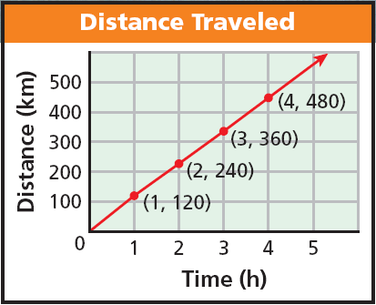
Linear Functions and Equations
Does the graph represent a functions?
Does it pass the vertical line test?
A function whose graph forms a straight line is called a linear function.
Now let’s learn 3 different ways of graphing Linear Equations! Jigsaw!

Slide 3
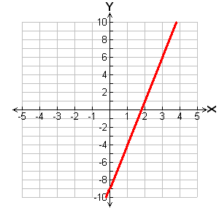
Method 1: Graphing a linear Functions using a table of values for two points
Graph the function:
–5x + y = – 9
To make things easier, solve for y first
y = 5x – 9
To graph, choose two values of x, and use them to generate ordered pairs. (You only need two points, but you can generate more to check )
Plot the points and connect them with a straight line.
X | y = 5x – 9 | (x, y)
0 | y = 5(0) – 9 = –9 | (0, –9)
2 | y = 5(2) – 9 = 1 | (2, 1)
•
•
•

Slide 4
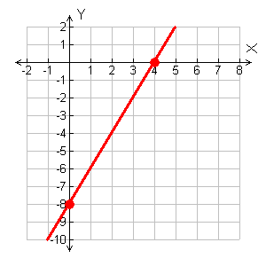
Method 2: Graphing a linear Functions by Finding the x- and y- intercepts:
You only need 2 points to graph a line: Find the x- and y-intercepts points and connect them with a straight line
x-intercept
The y-intercept is the point where the graph crosses the y-axis, (0, y).
Always zero!
The x-intercept is the point where the graph crosses the x-axis, (x, 0).
y-intercept
Graph the line, 4x – 2y = 16 by finding the intercepts.
To find y-intercept, since the x-coordinate is always zero, make x zero and then solve for y:
To find x-intercept, since the y-coordinate is always zero, make y zero and then solve for x:
4x – 2y = 16
4x – 2y = 16
4(0) – 2y = 16
4x – 2(0) = 16
–2y = 16
4x = 16
y = –8
x = 4
(0, –8)
Graph these two points and connect
(4, 0)

Slide 5
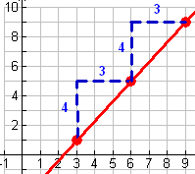
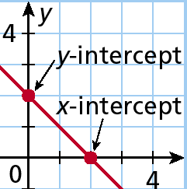
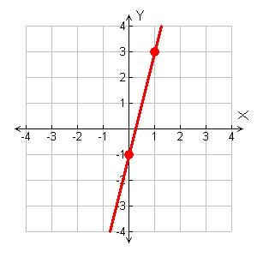
3.Graphing a linear Function by Finding the Slope and y- intercept:
You only need two points to graph a line: Find the y-intercept and then use the slope to find a second point. Connect the two points.
The slope of a line is how steep the line is. To figure out how steep the line is we divide the rise of the line over the run of the line; “rise over run”
The y-intercept is the point where the graph crosses the y-axis, (0, y).
The slope of the line is:
Graph –4x + y = –1 using slope and y-intercept:
To find slope and y-intercept, solve for y:
y = mx + b; m = slope and b = y-intercept
–4x + y = –1
Graph: Start at y-intercept then use slope to get to second point
y-int: (0, -1)
y = 4x – 1
Slope is 4 (write as fraction, 4/1... Rise 4 Run 1)

