Slide 1
Learning Goals
Identify and graph parallel and perpendicular lines.
Write equations to describe lines parallel or perpendicular to a given line.
Vocabulary
parallel lines
perpendicular lines
Warm Up
Find the reciprocal.
1. 2 2. 3.

Slide 2
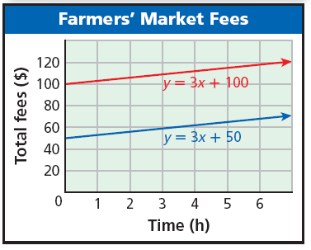
Why learn this? Helps us analyze data of different topics:
To sell at a particular farmers’ market for a year, there is a $100 membership fee. Then you pay $3 for each hour that you sell at the market. However, if you were a member the previous year, the membership fee is reduced to $50.
The red line shows the total cost if you are a new member.
The blue line shows the total cost if you are a returning member.
What can you say about these two lines?
Which line do you prefer? Always?

Slide 3
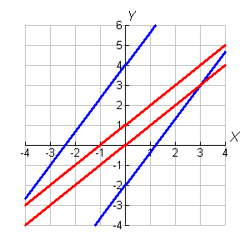
Same slope different y-intercept
Example 1A: Identifying Parallel Lines
Identify which lines are parallel.

Slide 4
Example 1B: Identifying Parallel Lines
Identify which lines are parallel.

Slide 5
Check It Out! Example 1a
Identify which lines are parallel.
y = 2x + 2; y = 2x + 1; y = –4; x = 1

Slide 6
Perpendicular lines are lines that intersect to form right angles (90°).

Slide 7
Helpful Hint
If you know the slope of a line, the slope of a perpendicular line will be the "opposite reciprocal.”

Slide 8
Check It Out! Example 3
Identify which lines are perpendicular: y = –4; y – 6 = 5(x + 4); x = 3; y =

Slide 9
Example 5A: Writing Equations of Parallel and Perpendicular Lines
Write an equation in slope-intercept form for the line that passes through (4, 10) and is parallel to the line described by y = 3x + 8.

Slide 10
Example 5B: Writing Equations of Parallel and Perpendicular Lines
Write an equation in slope-intercept form for the line that passes through (2, –1) and is perpendicular to the line described by y = 2x – 5.

Slide 11
Are the lines represented by the equations parallel, perpendicular, or neither?

