Slide 1
Learning Targets
Graph a line and write a linear equation using point-slope form.
Write a linear equation given two points.
Warm Up
Find the slope of the line containing each pair of points.
1. (3, 3) and (12, –15)
Write the following equations in slope-intercept form.
2. y – 5 = 3(x + 2)

Slide 2
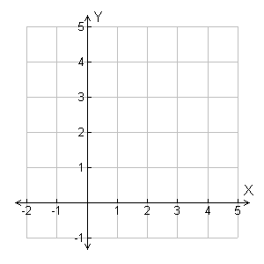
Example 1A: Using Slope and a Point to Graph
Graph the line with the given slope that contains the given point.
slope = 2; (3, 1)
Step 1 Plot (3, 1).
Step 2 Use the slope to move from (3, 1) to another point.
1
•
2
•
(3, 1)
Move 2 units up and 1 unit right and plot another point.
Step 3 Draw the line connecting the two points.

Slide 3
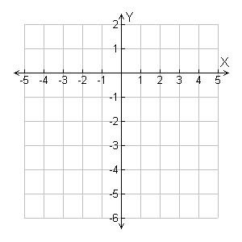
Example 1C: Using Slope and a Point to Graph
Graph the line with the given slope that contains the given point.
slope = 0; (4, –3)
•
(4, –3)

Slide 4
Suppose a line has a slope of 3 and contains (2, 1). Let (x, y) be any point on the line.
Substitute into the slope formula.
Slope formula
Multiply both sides by (x – 2).
3(x – 2) = y – 1
Simplify.
y – 1 = 3(x – 2)

Slide 5
Example 2: Writing Linear Equations in Point-Slope Form
Write an equation in point-slope form for the line with the given slope that contains the given point.
A.
B.
C.

Slide 6
Example 3: Writing Linear Equations in Slope-Intercept Form
Write an equation in slope-intercept form for the line with slope 3 that contains (–1, 4).
Step 1 Write the equation in point-slope form:
y – y₁ = m(x – x₁)
y – 4 = 3[x – (–1)]
Step 2 Write the equation in slope-intercept form by solving for y.
y – 4 = 3(x + 1)
y – 4 = 3x + 3
+ 4 + 4
y = 3x + 7

Slide 7
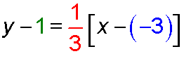
Check It Out! Example 3
Write an equation in slope-intercept form for the line with slope that contains (–3, 1).
Step 1 Write the equation in point-slope form:
y – y₁ = m(x – x₁)
Add 1 to both sides.

Slide 8
Example 4A: Using Two Points to Write an Equation
Write an equation in slope-intercept form for the line through the two points.
(2, –3) and (4, 1)

Slide 9
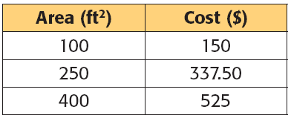
Example 5: Problem-Solving Application
The cost to stain a deck is a linear function of the deck’s area. The cost to stain 100, 250, 400 square feet are shown in the table. Write an equation in slope-intercept form that represents the function. Then find the cost to stain a deck whose area is 75 square feet.

Slide 10
Example 5 Continued
3
Solve
Step 1 Choose any two ordered pairs from the table to find the slope.
Use (100, 150) and (400, 525).
Step 2 Substitute the slope and any ordered pair from the table into the point-slope form.
y – y₁ = m(x – x₁)
y – 150 = 1.25(x – 100)
Use (100, 150).

Slide 11
Example 5 Continued
Step 3 Write the equation in slope-intercept form by solving for y.
y – 150 = 1.25(x – 100)
y – 150 = 1.25x – 125
Distribute 1.25.
y = 1.25x + 25
Add 150 to both sides.
Step 4 Find the cost to stain an area of 75 sq. ft.
y = 1.25x + 25
y = 1.25(75) + 25 = 118.75
The cost of staining 75 sq. ft. is $118.75.

