Slide 1
5.6 – The Quadratic Formula And Ch 5 Review
Objectives
ax² + bx + c = 0
Solve quadratic equations using the Quadratic Formula.

Slide 2
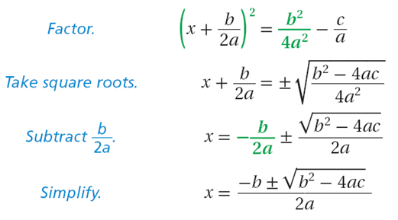
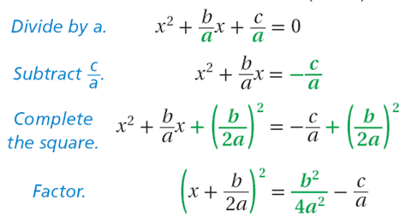
Solve:

Slide 3
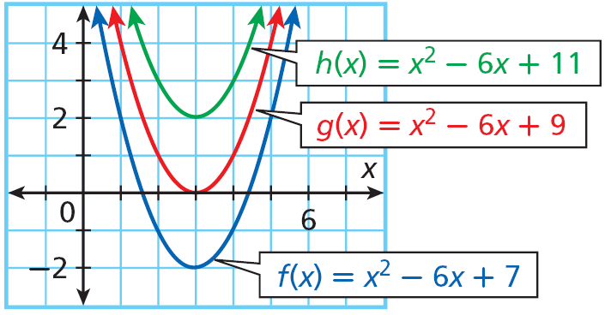
Example 1: Quadratic Functions with Real Zeros
Find the zeros of f(x)= 2x² – 16x + 27 using the Quadratic Formula.
2x² – 16x + 27 = 0
Set f(x) = 0.

Slide 4
Check It Out! Example 1a
Find the zeros of f(x) = x² + 3x – 7 using the Quadratic Formula.
x² + 3x – 7 = 0
Set f(x) = 0.

Slide 5
Properties of Solving Quadratic Equations
ax² + bx + c = 0
9x² + 6x + 1 = 0
8x² + 4x = 0
2x² - 4 = 0

Slide 6
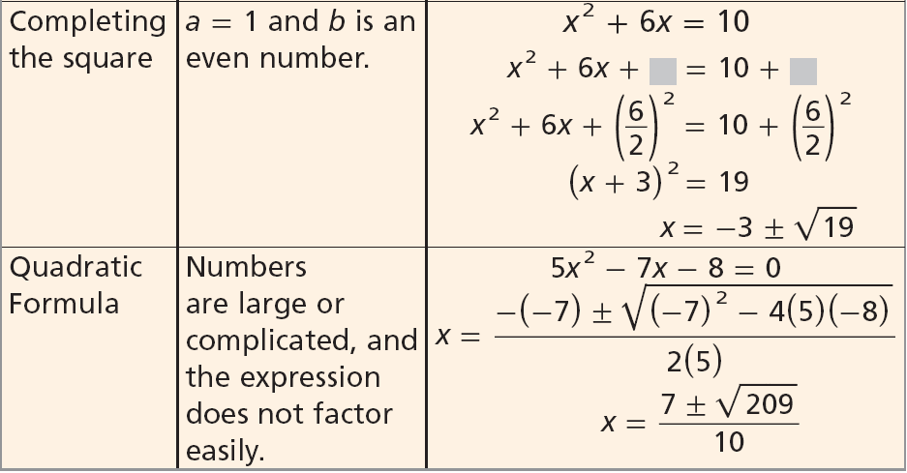
Properties of Solving Quadratic Equations

Slide 7
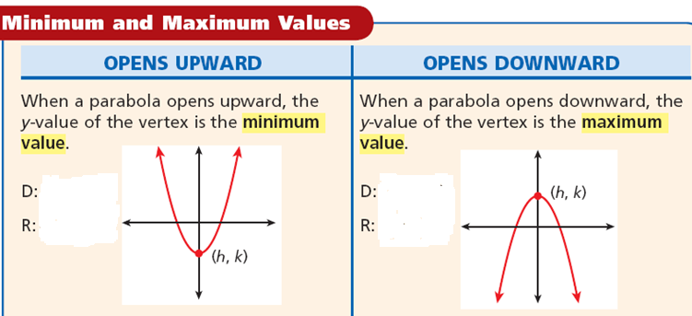
Draw a picture

