Slide 1
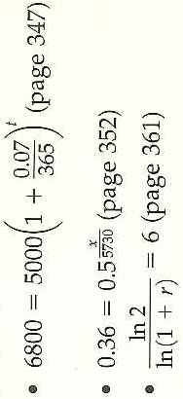
5.6 Solving Exponential and Logarithmic Equations
Objectives:
Solve exponential and log equations
Solve a variety of application problems by using exponential and log equations
Review: What are two ways of solving the following:

Slide 2
Remember the Definition of a Function
We can make both sides an exponent of base b or log both sides
Exponential and log functions are one-to-one functions, therefore:
We can drop the bases or drop the logs

Slide 3
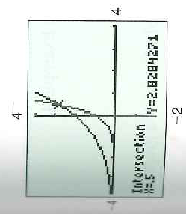
Exponential Equations: Example 1: Powers of the Same Base
Another way to confirm?

Slide 4
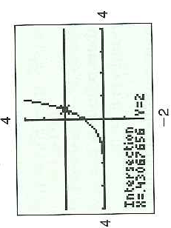
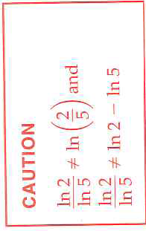
Example 2: Powers of Different Bases
Need to learn the tricks!

Slide 5
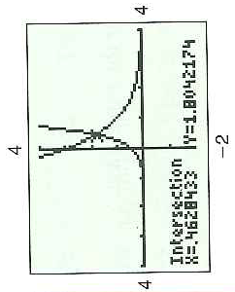
Example 3: Powers of Different Bases
Which graph is which?→

Slide 6
Example 4: Using Substitution

Slide 7
Logarithmic Equations: Example 9: Equations with Only Log Terms

Slide 8
Example 10: Equations with Logs and Constant Terms
Remember:

Slide 9
Example 11: Equations with Logs and Constant Terms

Slide 10
5.6 Hmwr: 1-29odd, 35-51odd

