Slide 1
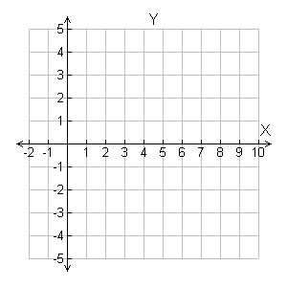
Example 1A: Graphing by Using Slope and y-intercept
Graph the line given the slope and y-intercept.
y intercept = 4
y
Rise = –2
•
•
Step 1 The y-intercept is 4, so the line contains (0, 4). Plot (0, 4).
•
•
Step 2 Slope = Count 2 units down and 5 units right from (0, 4) and plot another point.
Run = 5
Step 3 Draw the line through the two points.

Slide 2
If you know the slope of a line and the y-intercept, you can write an equation that describes the line.
Step 1 If a line has a slope of 2 and the y-intercept is 3, then m = 2 and (0, 3) is on the line. Substitute these values into the slope formula.

Slide 3
Step 2 Solve for y:
Simplify the denominator.
•
•
Multiply both sides by x.
2x = y – 3
+3 +3
Add 3 to both sides.
2x + 3 = y, or y = 2x + 3

