Slide 1
5.5 Properties and Laws of Logarithms
Objective: Use properties and laws of logarithms to simplify and evaluate expressions
Review: What properties do we already know?:

Slide 2
Basic Properties of Logarithms:
Why?
Why?
Why?

Slide 3
A Logarithm is An Exponent!

Slide 4
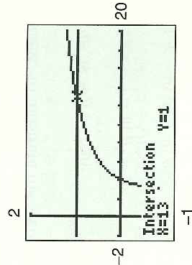
Example 1: Solving Equations by Using Properties of Logs

Slide 5
Laws of Logarithms: Logs are Exponents
Check that is true using the given!:

Slide 6
Example 2: Using the Product Law of Logs

Slide 7
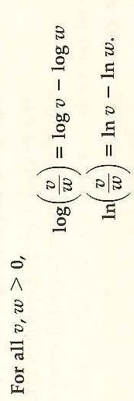
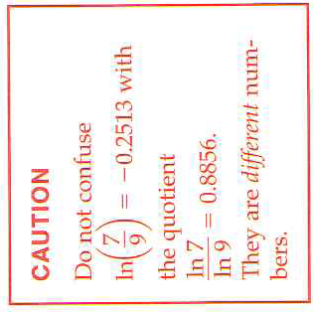
Quotient Law of Logs
Complete an illustrate for this law.

Slide 8
Example 3: Using the Quotient Law of Logs

Slide 9
Power Law of Logs
Exponent
Illustrate this law with:

Slide 10
Example 4: Using the Power Law of Logs

Slide 11
Example 5: Simplifying Expressions
Example 6: Simplifying Expressions: Use the properties and law of logs to make the expression more simple

Slide 12
5.5 Hmwr: pg. 369: 1-4, 5-25odd, 29-39odd 40

