Slide 1
5.4 Common and Natural Logarithmic Functions
Quiz next class!
Objectives:
Evaluate common and natural logs with and without calculator
Solve common and natural exponential and log equations by using an equivalent equation!
Graph and identify transformations of common and natural log functions

Slide 2
Before Calculators We had Logs!
Very useful for astronomy, chemistry, physics, and engineering
Still important for sciences and engineering
Today: Two most important types of logs
Base 10 and Base e.

Slide 3
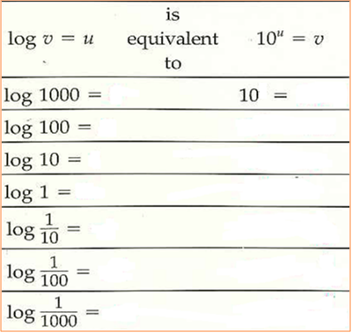
Common Logarithms: Base 10

Slide 4
Logarithms are Special Exponents
Example 1: Evaluating Common Logarithms

Slide 5
Example 2: using Equivalent Statements
Can be helpful:

Slide 6
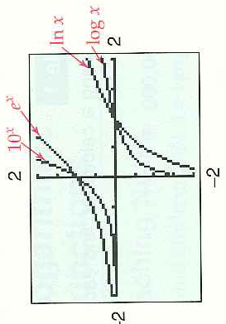
Natural Logarithms: Base e (instead of base 10)

Slide 7
Example 3: Evaluating Natural Logarithms: Ln
Qu: How can we check to see if we did the calculations right?

Slide 8
Example 4: Solving by Using an Equivalent Statement
Qu: Do you see a statement?

Slide 9
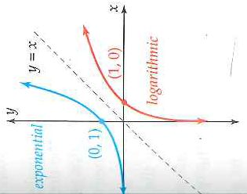
Graphs of Logarithmic Functions
Think of all the graphs of the different exponential functions:
The graphs of logarithmic functions have common characteristics also.
What is the asymptote for each graph?
Why is the domain of an exp. fn. the range of its corresponding log fn?

Slide 10
Example 5: Transforming Logarithmic Functions

Slide 11
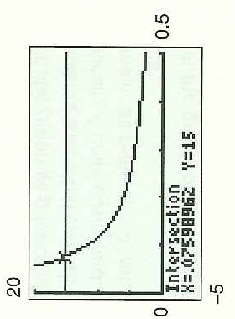
Example 7: Solving Logarithmic Equations Graphically
Understand the graph!
What does the x and y values represent
What is the input and output

Slide 12
5.4 Hmwr; p. 361: 1,3, 7-13odd, 23-37odd, 43-49odd, 67 Study for Quiz 5.1/5.2/5.4

