Slide 1
5.4 Completing the Square and Solving by Square Root Method
ax² + bx + c = 0
Sometimes it is easier to solve a quadratic equation by using a different method other than factoring. Sometimes you cannot even solve the quadratic equation by factoring.
Objectives
Solve quadratic equations by taking the square root of both sides
Solve quadratic equations by completing the square.
Write quadratic equations in vertex form.
Vocabulary
completing the square

Slide 2
We have learned to solve quadratic equations by factoring:
x² + 16 = 0
Can you think of a easier method for solving the quadratic equation?

Slide 3
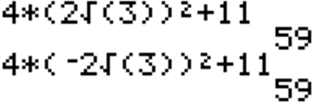
Example 1A: Solving Equations by Using the Square Root Property
Solve the equation.
4x² + 11 = 59

Slide 4
Solving quadratic equations by factoring:
x² + 7x - 8 = 0
x² + 8x +16 = 0

Slide 5
Example: Solve the equation by completing the square.
x² = 12x – 20

Slide 6
Example: Solve the equation by completing the square.
18x + 3x² = 45

Slide 7
Recall the vertex form of a quadratic function from lesson 5-1:
f(x) = a(x – h)² + k, where the vertex is (h, k).
You can complete the square to rewrite any quadratic function in vertex form.
Helpful Hint
In Example 3, the equation was balanced by adding to both sides. Here, the equation is balanced by adding and subtracting on one side.

Slide 8
Example 4A: Writing a Quadratic Function in Vertex Form
Write the function in vertex form, and identify its vertex.
f(x) = x² + 16x – 12

Slide 9
Example 4B: Writing a Quadratic Function in Vertex Form
Write the function in vertex form, and identify its vertex
g(x) = 3x² – 18x + 7

