Slide 1
5.4 The Slope Formula Quiz next class
Objective
Find slope by using the slope formula.
Understand what slope represents in real-world context
Warm Up
Add or subtract.
1. 4 + (–6) 2. –3 + 5
3. –7 – 7 4. 2 – (–1)
Find the x- and y-intercepts.
5. x + 2y = 8 6. 3x + 5y = –15

Slide 2
Example 1: Finding Slope by Using the Slope Formula
Find the slope of the line that contains (2, 5) and (8, 1).

Slide 3
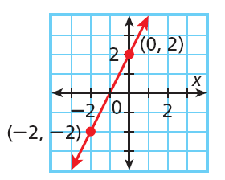
Sometimes you are not given two points to use in the formula. You might have to choose two points from a graph or a table.
Example 2A: Finding Slope from Graphs and Tables
The graph shows a linear relationship. Find the slope.
Let (0, 2) be (x₁, y₁) and (–2, –2) be (x₂, y₂).

Slide 4
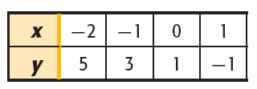
Example 2B: Finding Slope from Graphs and Tables
The table shows a linear relationship. Find the slope.

Slide 5
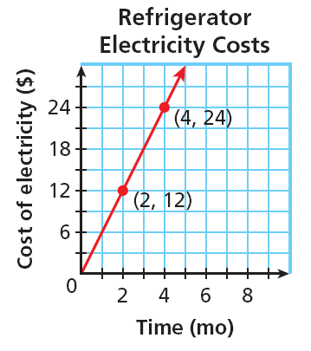
Remember that slope is a rate of change. In real-world problems, finding the slope can give you information about how a quantity is changing.
Example 3: Application
The graph shows the average electricity costs (in dollars) for operating a refrigerator for several months. Find the slope of the line. Then tell what the slope represents.
Step 1 Use the slope formula.
Step 2 Tell what the slope represents.
In this situation y represents __________________and x represents _________
slope represents:
A slope of 6 means:

Slide 6
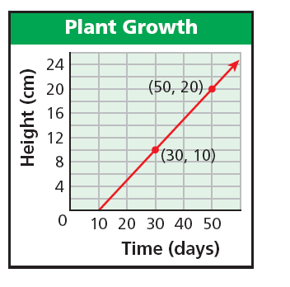
Check It Out! Example 3
The graph shows the height of a plant over a period of days. Find the slope of the line. Then tell what the slope represents.
Step 1 Use the slope formula.
Step 2 Tell what the slope represents.
slope represents:
A slope of mean the plant grows at rate of 1 centimeter every two days.
OR:

Slide 7
Remember, if you know the equation that describes a line, you can find its slope by rearranging the equation in terms of y: y = mx+b
Example 4: Finding Slope from an Equation
Find the slope of the line described by 4x – 2y = 16.

