Slide 1
5.2 Exponential Functions
Objectives:
Graph and identify transformations of exponential functions
Use exponential functions to solve application problems
Fill in the chart then sketch the graph!
x | -2 | -1 | 0 | 1 | 2 | 3
f(x)=2^x
x | -2 | -1 | 0 | 1 | 2 | 3
f(x)=(1/2)^x

Slide 2
Graphs of Exponential Functions
How come we cannot have an exponential function with a negative base?

Slide 3
Graphing Exploration:
Large base = rise more steep
Small base = fall more steep
What will the graph look like once the base gets to 1?

Slide 4
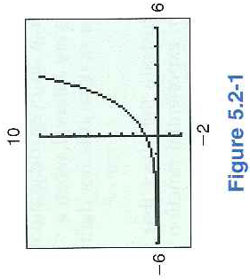
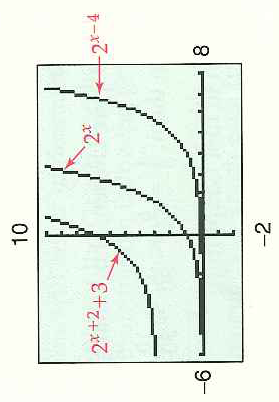
Example 1: Translations: Review

Slide 5
Exponential Functions Increase at a Crazy Rate!
f(x)=2^x x=50

Slide 6
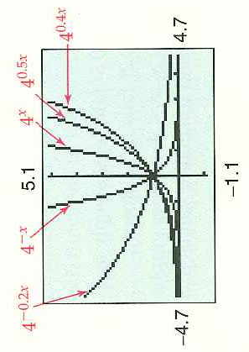
Example 2: Horizontal Stretches

Slide 7
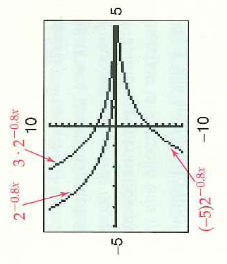
Example 3: Vertical Stretches

Slide 8
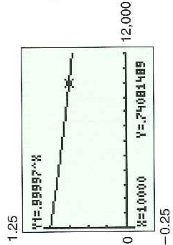
Applications: Exponential Growth or Exponential Decay
Differences?
Example 4: Radioactive Decay
Solution:
Remember: when base close to 1 it does things slowly!
What is the morale of the story?

Slide 9
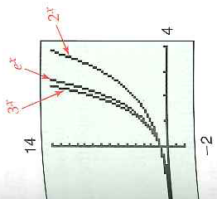
The Number e and the Natural Exponential Function
Using e as a base for exponential functions!
Let’s Practice!

Slide 10
Example 7: Population Growth
What does P stand for? And t stand for?
Look a graph p. 341
Let’s be realistic about this model!

Slide 11
Example 8: Logistic Model
Where is the horizontal asymptote?
Rewrite the function with only positive exponents and then explain why the function value approaches 20 000.

Slide 12
5.2 Hmwr: p. 343: 3, 5, 11, 13-17odd, 21, 51a, 55a, 57a, 41, 45

