Slide 1
5.2-Inequalities and Triangles
Objectives:
Learn 3 more theorems about triangles
1st Question: Think about it!
If I have two numbers what can you tell me about those two numbers?

Slide 2
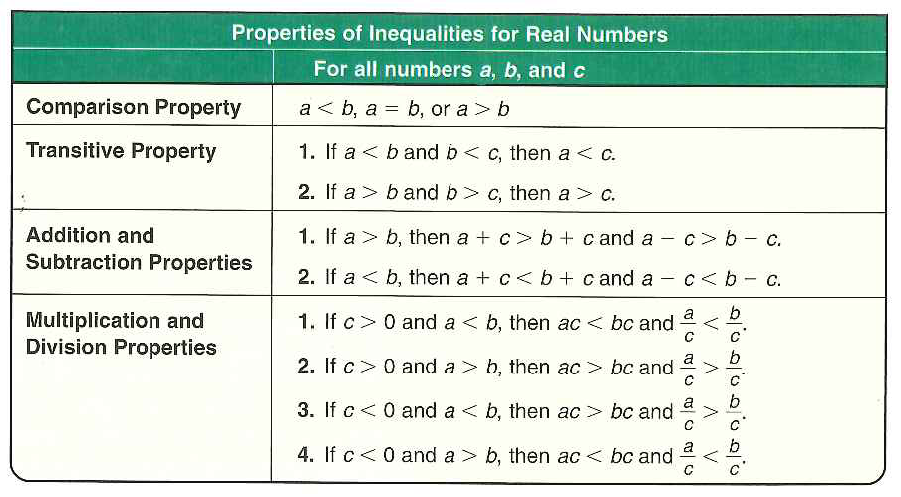
Some Key concepts About Inequalities:

Slide 3
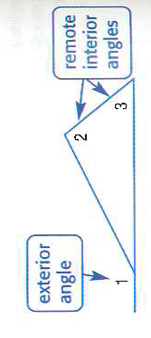
The Exterior Angle Theorem Leads us to New Theorems
Exterior angle theorem says the measure of the exterior angle is equal to the sum of the measures of the interior remote angles
This theorem along with the definition of inequality will prove:
The Exterior Angle Inequality Theorem.

Slide 4
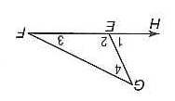
Using The Exterior Angle Theorem

Slide 5
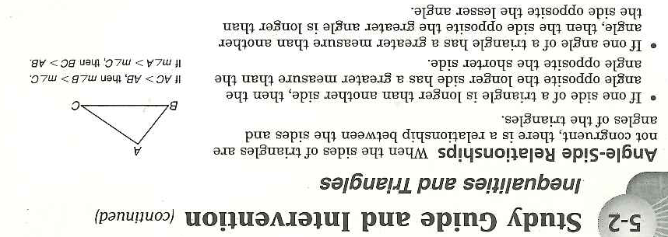
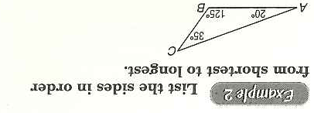
From now on remember these three theorems!

