Slide 1
5.1 Radicals and Rational Exponents
Objectives
Define and apply rational and irrational exponents
Simplify expressions containing radicals or rational exponents

Slide 2
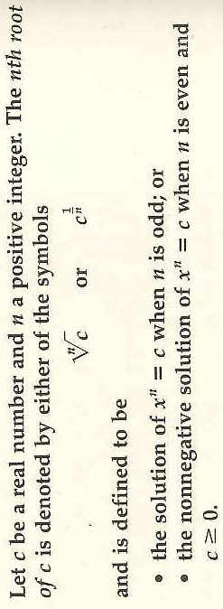
Nth Roots
Examples:
check
Remember for simplification:

Slide 3
Example 1: Operations on nth Roots

Slide 4
Example 2: Evaluating nth Roots using a Calculator to the nearest Ten-thousandth
Caution: Use brackets!
Can simplify exponent
Cannot simplify

Slide 5
Rational Exponents
What are rational exponents of the form 1/n called?
Rational exponents can also be of the form m/n.

Slide 6
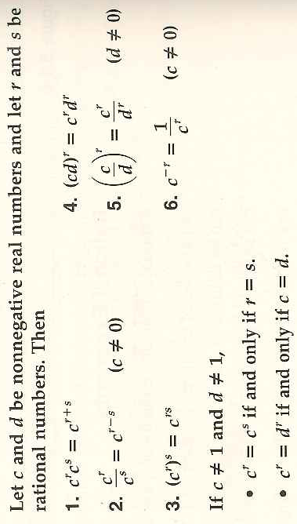
Laws of Exponents (when are Exponents are Fractions!)
Why is this important?

Slide 7
Example 3: Your Turn: Simplifying Expressions with Rational Exponents

Slide 8
Example 4: Your Turn: Simplifying Expressions with Rational Exponents

Slide 9
Example 5: Your Turn: Simplifying Expressions with Rational Exponents

Slide 10
Example 6: Your Turn: Simplifying Expressions with Rational Exponents

Slide 11
Rationalizing Denominators and Numerators Example 7: Rationalizing the Denominator
Hint:

Slide 12
Example 8: Our Last: Rationalizing the Numerator
What is this quotient called?
Why do I keep coming back to this?

Slide 13
5.1 hmwr:

