Slide 1
5.1 The Perpendicular Side Bisectors, Angle Bisectors, Medians, and Altitudes of a Triangle

Slide 2
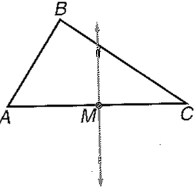
Perpendicular Side Bisector
Definition:
A line that passes through the midpoint of the side of a triangle and is perpendicular to that side.

Slide 3
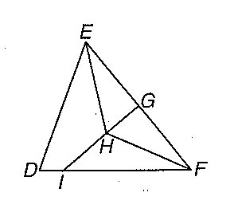
Special Properties of Perpendicular Bisectors
Example: Using Th’m to get an equation:

Slide 4
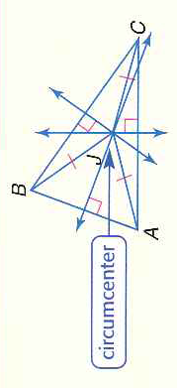
Concurrent Lines: Points of Concurrency
Triangle has 3 sides ∴ there are 3 perpendicular bisectors in a triangle
Something beautiful:
The 3 lines intersect at a common point called the circumcenter!
Concurrent lines: Three or more lines that intersect at the same point
Point of concurrency: The point where the concurrent lines cross.

Slide 5
Points of Concurrency are Special!!!
Does this Theorem make sense?
Can we prove it is true?

Slide 6
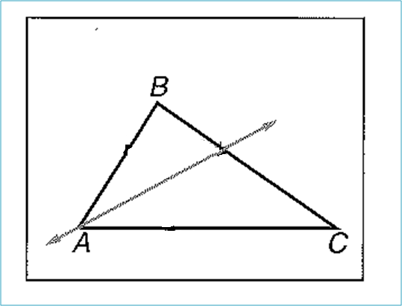
Angle Bisectors
Definition:
A line that passes through the exact middle of an angle

Slide 7
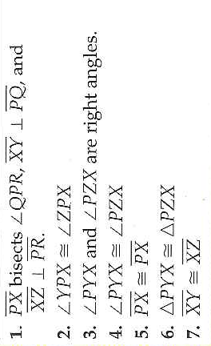
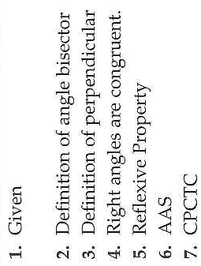
Special Properties of Points on Angle Bisector

Slide 8
Example: Use the Th’m to make an equation

Slide 9
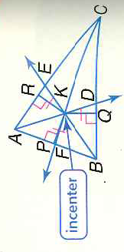
Angle Bisectors are Concurrent
Point of Concurrency: incenter
Remember: Points of Concurrency are special:

Slide 10
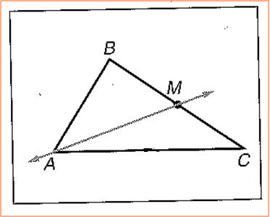
Median
Definition:
A segment whose endpoints are the vertex of a triangle and the midpoint of the opposite side

Slide 11
Medians are Concurrent!
Point of Concurrency: Centroid
Interesting Fact: The centroid is the point of balance for any triangle.
What is so special about this point of concurrency?

Slide 12
Example: Using the Th’m to make an equation.

Slide 13
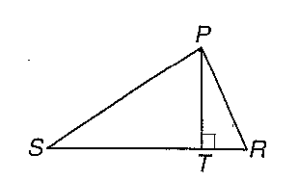
Altitude
Definition:
A segment from a vertex to the opposite side and it is perpendicular to the opposite side.
*In some triangles the medians and altitudes are the same

Slide 14
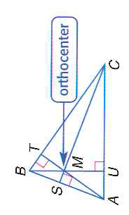
Altitudes are concurrent
Point of concurrency: orthocenter

Slide 15
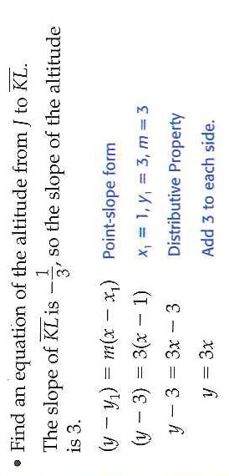
Use a System of Equations to Find the orthocenter
Please find an equation of the altitude from K to line JL

Slide 16
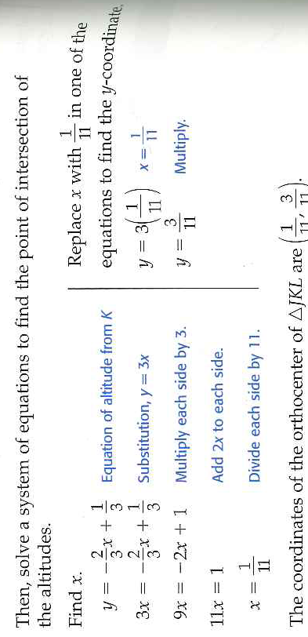

Slide 17
Assessment:

Slide 18
Assessment:

