Slide 1
4.5 Scatter Plots and Trend Lines
Objectives
Create and interpret scatter plots.
Use trend lines to make predictions.
Vocabulary
scatter plot
correlation
positive correlation
negative correlation
no correlation
trend line

Slide 2
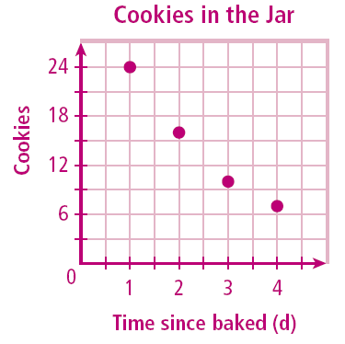
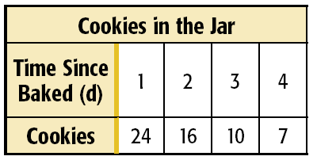
Example 1: Graphing a Scatter Plot from Given Data
The table shows the number of cookies in a jar from the time since they were baked. Graph a scatter plot using the given data.
Use the table to make ordered pairs for the scatter plot.
The x-value represents the time since the cookies were baked and the y-value represents the number of cookies left in the jar.
Plot the ordered pairs.

Slide 3
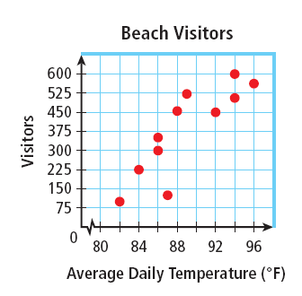
A correlation describes a relationship between two data sets.
Example 2: Describing Correlations from Scatter Plots
Describe the correlation illustrated by the scatter plot.
As the average daily temperature increased, __________________________
There is a _______________ correlation between the two data sets.

Slide 4
Example 3A: Identifying Correlations
Identify the correlation you would expect to see between the pair of data sets. Explain.
The average temperature in a city and the number of speeding tickets given in the city
The number of people in an audience and ticket sales
A runner’s time and the distance to the finish line

Slide 5
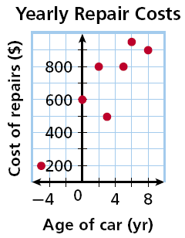
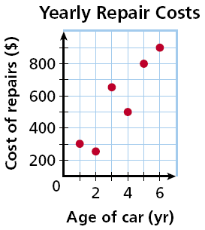
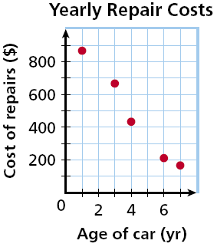
Example 4: Matching Scatter Plots to Situations
Choose the scatter plot that best represents the relationship between the age of a car and the amount of money spent each year on repairs. Explain.
Graph A
Graph B
Graph C

Slide 6
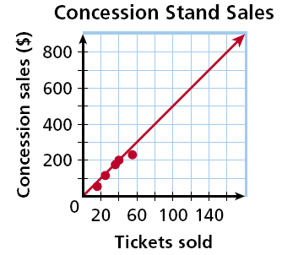
You can graph a line on a scatter plot to help show the relationship. This line, called a trend line, is used to make predictions.
Example 5: Fund-Raising Application
The scatter plot shows a relationship between the total amount of money collected at the concession stand and the total number of tickets sold at a movie theater. Based on this relationship, predict how much money will be collected at the concession stand when 150 tickets have been sold.
Draw a trend line and use it to make a prediction.
Draw a line that has about the same number of points above and below it. Your line may or may not go through data points.
Find the point on the line whose x-value is 150. The corresponding y-value is 750.
Based on the data, $750 is a reasonable prediction of how much money will be collected when 150 tickets have been sold.

