Slide 1
4.4 Rational Functions
Objectives:
Find the domain of a rational function
Find intercepts, vertical asymptotes, and horizontal asymptotes
Identify holes
Describe end behaviour
Sketch complete graphs

Slide 2
Rational Functions – What are they?
It is a function whose rule is the quotient of two polynomials:
What is the domain of these functions?

Slide 3
Example 1: The Domain of a Rational Function

Slide 4
Properties of Rational Graphs
How do we find the x and y intercepts of f(x)?
Intercepts of Rational Functions

Slide 5
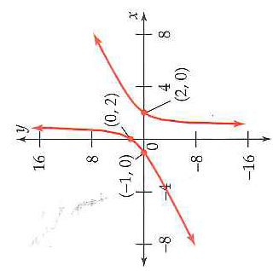
Example 2: Your Turn: Intercepts of a Rational Graph
Can you think of a rational function that has no x-intercepts and y-intercept?

Slide 6
Continuity –What do you think of?
Rational Functions are continuous everywhere except for x-values not in the domain.
At these x-values (the zeros of the denominator) there is a break in the function
2 types of breaks: Vertical Asymptotes and Holes

Slide 7
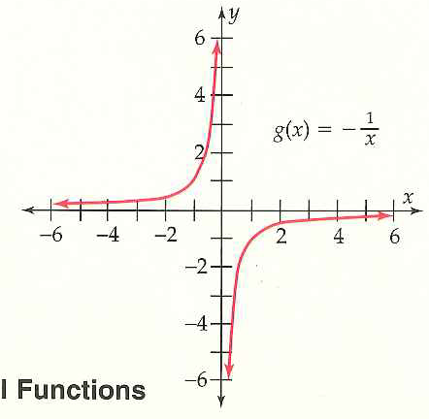
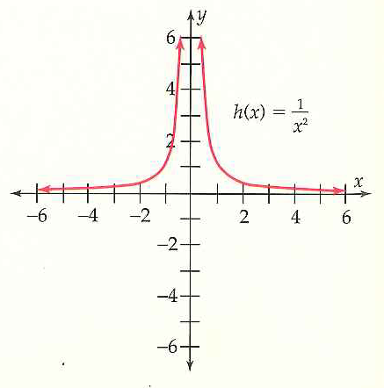
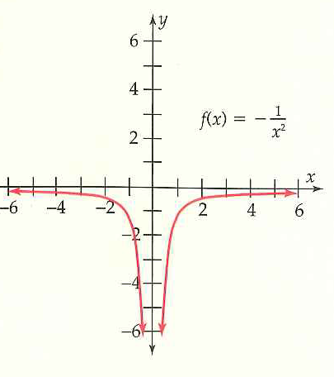
Vertical Asymptotes – What are they and when do they Occur?
Examples Please!!

Slide 8
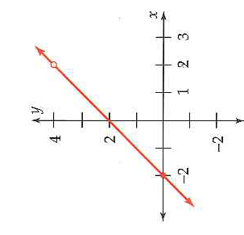
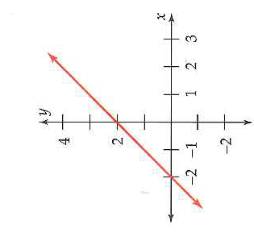
Holes – the 2nd way for Discontinuity
Make the function more simple:

Slide 9
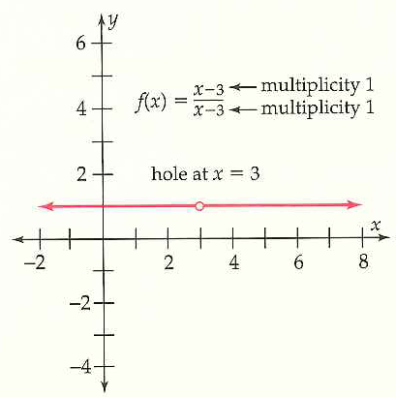
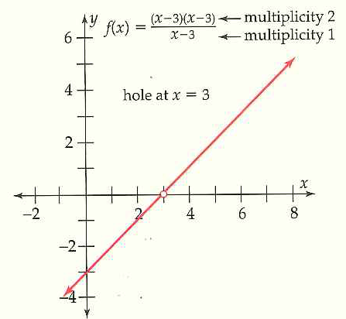
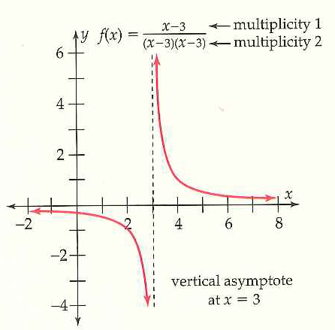
Holes – When they Occur:

Slide 10
The Big-Little Concept
Examples:

Slide 11
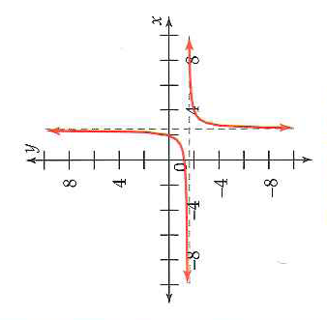
End Behaviour of Rat Fn – End Behaviour?
Example 3a: End Behaviour

Slide 12
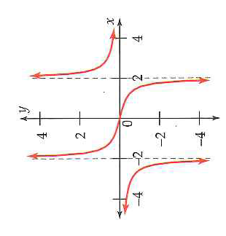
Example 3b: End Behaviour of Rat Fn
Notice horizontal asymptote only occurs at for the end behaviour!

Slide 13
Example 3c: Your Turn: Sketch the graph: Find Intercepts, Vertical and Horizontal Asymptotes, Any Holes

Slide 14
4.4 Hmwr: 1-11odd, 25-41odd

