Slide 1
4.3 Graphs of Polynomial Functions
Objective:
Recognize the shape of basic polynomial functions
Describe the graph of a polynomial function
Identify properties of general polynomial functions: Continuity, End Behaviour, Intercepts, Local Extrema, Points of Inflection
Identify complete graphs of polynomial functions
Basically we are learning about the graphs of higher degree polynomial functions in order to interpret these graphs correctly and know if they are complete

Slide 2
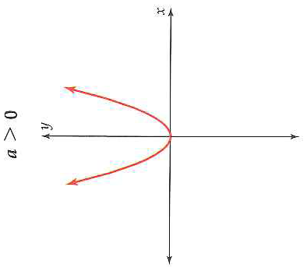
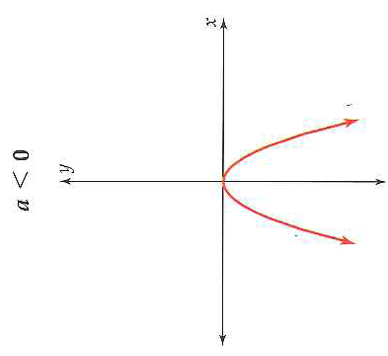
The Basic Polynomial Shapes
The parent functions of the different polynomials are always in the form f(x) = ax^{n}
There are two basic shapes when n ≥ 2.
Basic Shape for Even Degree:

Slide 3
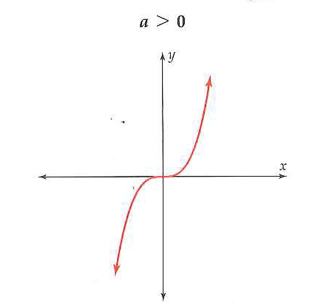
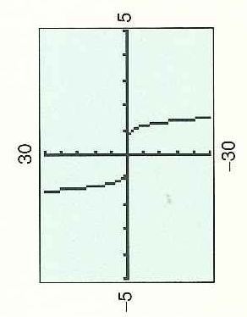
Basic Shape for Odd Degree Polynomials
Only when we add more to the function rule does the basic shape change.

Slide 4
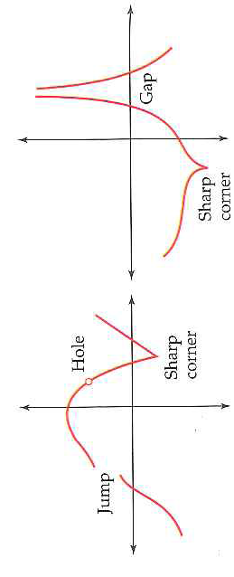
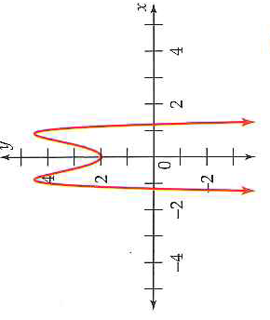
Properties of General Poly Fn: Continuity
Are the above functions polynomials? No!
Every graph of a polynomial function is continuous (cts) and with no sharp turns.
Why?

Slide 5
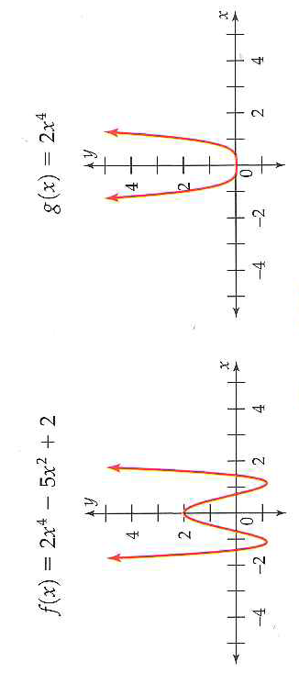
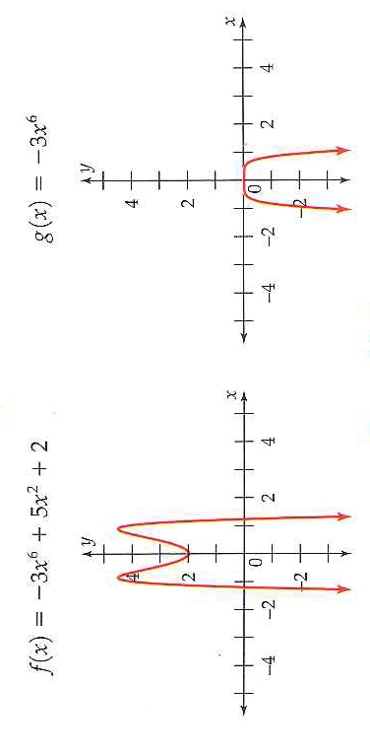
End Behaviour: What does the graph look like When the Inputs are large Positive and Negative X-Values (Aka. Large|X|-Values)

Slide 6
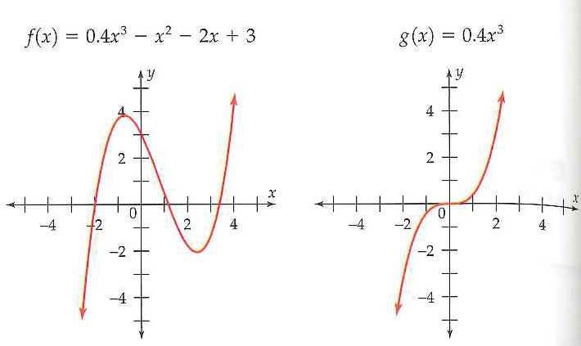
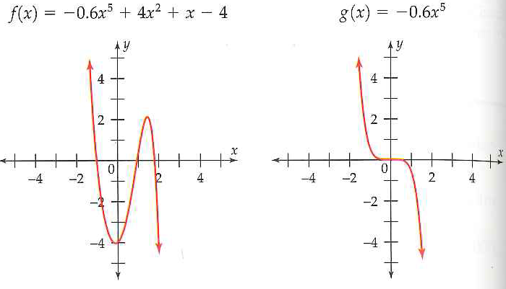
End Behaviour for Odd Degree:

Slide 7
X and Y- Intercepts
Draw four quadratic functions: 1st with no zeros/x-intercepts, 2nd with one zero, 3rd with two zeros, 4th with no y-intercept.
Which functions do not have an x-intercept?

Slide 8
An Example of Multiplicity:
Multiplicity and Graphs:
Everyone: Where does our function cross the x-axis and where does it only touch (kiss!) the x-axis?

Slide 9
Critical Thinking: Make a Prediction about Number of Extrema and Points of Inflection for a Polynomial of Degree n
Definitions:
An local extrema is a local maximum or local minimum
A point of inflection is the point where the concavity of a graph of a function changes
Concavity is the way a curve bends: either concave up or concave down
Number of Local Extrema: A polynomial function of degree n has at most n – 1 local extrema
What does this mean? Ex: A polynomial with degree 4 could have 3 local extrema, 2 local extrema, or 1 local extremi
Number of Points of Inflection: The graph of a polynomial function of degree n, with n ≥ 2, has at most n – 2 points of inflection.

Slide 10
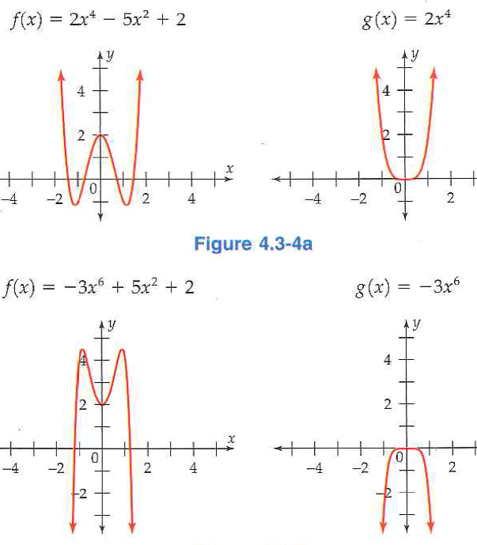
Number of Local Extrema
Circle the function that has less than n-1 local extrema?

Slide 11
Number of Points of Inflection
Questions to answer:
How many points of inflection does an quadratic have (degree 2)? Answer this question using the above rule. Then draw a picture to confirm your results.
How many points of inflection does a cubic have? Draw a picture. Think and explain why we need the second rule for odd functions:

Slide 12
Ex 1: A Complete Graph of a Polynomial
Is this a complete graph of the function:
Questions to ask:
Does it show the y-intercept?
Yes!
Does it show all the extrema?
Yes: poly of degree 4 can have at most 3 extremas. There are 3 in the picture so there cannot be any more even if we extend the axes
Does it show all the x-intercepts?
Yes: poly with degree 4 can have at most 4 x-intercepts. This one only has 2 but I know there is not any more if the graph turned down again towards the x-axis there would be another extrema which is impossible
Is the end behaviour correct?
Yes: even degree polynomial with positive leading coefficient should have both ends going up.
Therefore, the graph of this poly fn is complete (it shows all important features)

Slide 13
Our Last Example: A complete Graph?
Questions to ask:
Does it show the y-intercept? Yes!
Does it show all the extrema?
Maybe: poly of degree 5 can have at most 4 extrema. There is 3 in the picture meaning if we extend the axes we might find another or we might not. More investigation is needed to answer (let us continue because one of the next questions could easily tell us if the graph is complete)
Does it show all the x-intercepts?
Maybe: poly of degree 5 can have at most 5 x-intercepts. This graph shows 4 (same issue as just describe). We would have to factor the polynomial in order to be certain.
Is the end behaviour correct?
No!: odd degree polynomial with positive leading coefficient has the left end going down and the right end going up. This graph shows the left end going up.
Therefore, the graph of this poly fn is not complete (we need to extend the viewing window

Slide 14
Our last example Continue: A complete Graph
Adding Figure 4.3-9b gives a complete graph. We still need Figure 4.3-9a in order to see the curves that happen very close to the origin
With the two graphs we now see that the end behaviour is correct. Also now we can be certain that we see all the extrema and x-intercepts.
Therefore, these two graphs show all the important features the polynomial

Slide 15
4.3 Hmwr: p. 269: 1-4, 7-11odd, 15, 17, 19-24, 43, 44, 47, 58

