Slide 1
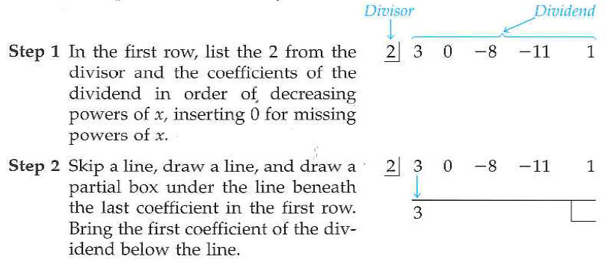
4.1 Continued: Synthetic Division
CAUTION:
Synthetic division can be used only when the divisor is x - c

Slide 2
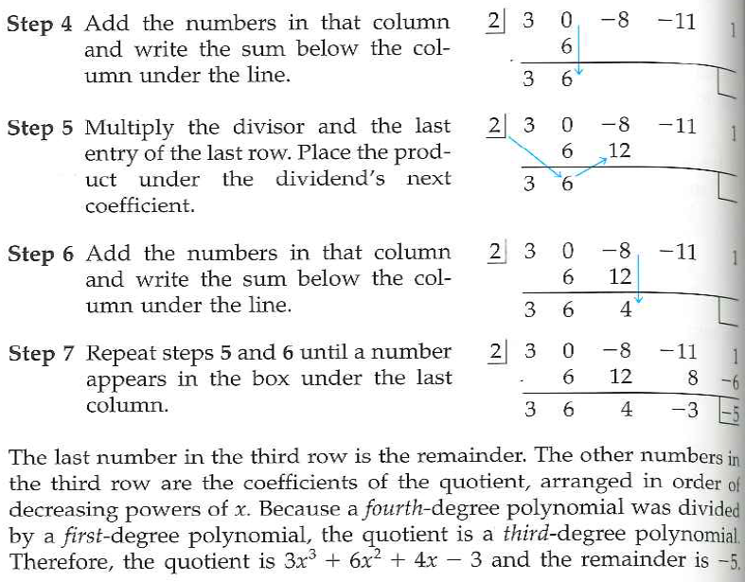
Your Turn: Use p. 242 for help if necessary

Slide 3
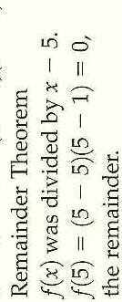
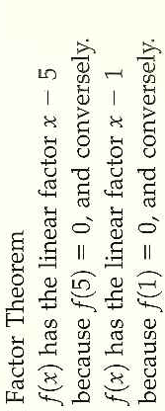
Review from 4.1

Slide 4
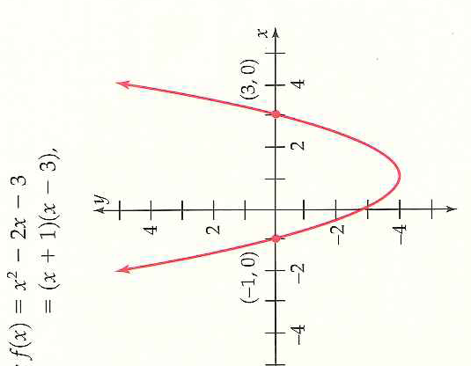
Review: If one statement is true then they are all True!
Vocabulary Needed:
Remember the zeros of a function are the x-values that make function zero

Slide 5
4.2 Real Zeros
Objectives:
Find all rational zeros of a polynomial function
Use the Factor Theorem
Factor a polynomial completely
Preview: In order to factor a polynomial we will follow these steps:
Find the rational zeros
Use the Factor Theorem to find linear factors and then divide.
Factor any other reducible factors down completely by either repeating step 1, by finding irrational factors on graphing calculator, or, if quadratic, by using the quadratic formula.

Slide 6
How to do Step One: The Rational Zero Test
Method of attack: Find all fractions that satisfy these conditions and test to see which ones are zero
How do we test to see if an x-value is a zero?

Slide 7
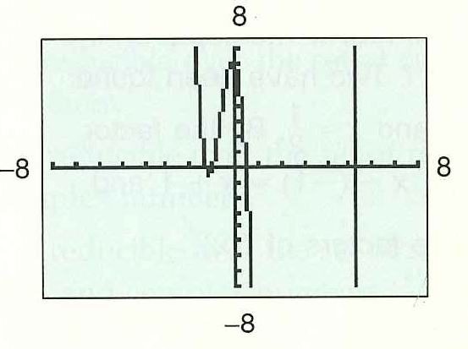
Example A: The Rational Zeros of a Polynomial

Slide 8
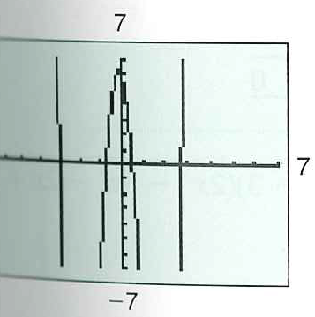
Example B: Your Turn: Use P. 251 for Help if Necessary!

Slide 9
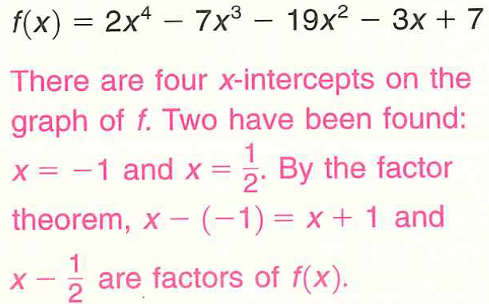
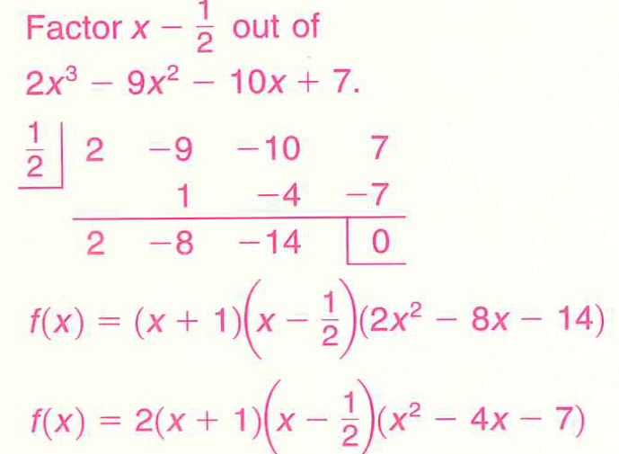
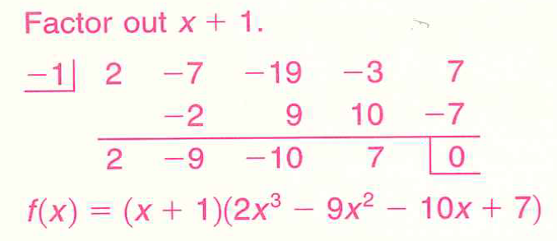
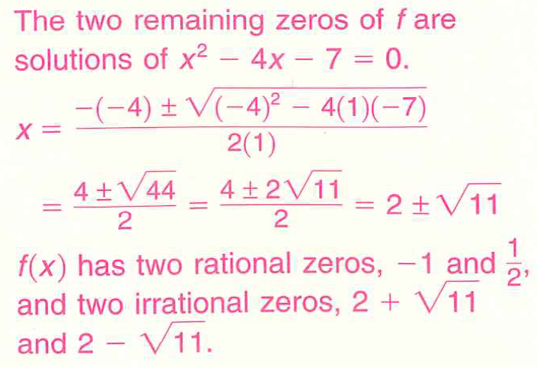
We Must Remember the Factor Theorem!
Therefore in our examples we have found some factors!
Ex a: Finding All Real Zeros of a Polynomial by Dividing Factors

Slide 10
Back to Your Example B! Finding All Real Zeros of a Polynomial by Dividing Factors to Find New Factors
Use pg. 252 to help if necessary!

Slide 11
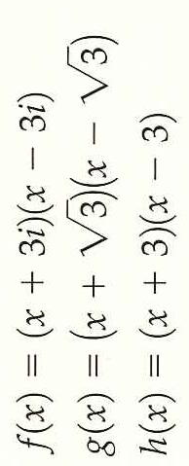
Irreducible and Completely Factored Polynomials
A irreducible polynomial: a polynomial that cannot be written as the product of polynomials of lesser degree
A completely factored polynomial over the set of real numbers: a polynomial written as the product of irreducible factors with real coefficients
Which polynomials would be irreducible?
Why am I mentioning over the set of real numbers?
Summary: What We Just Did:
Steps to factor a polynomial:
Find the rational zeros
Use the Factor Theorem to find linear factors and then divide.
Factor any other reducible factors down completely by either repeating step 1, by finding irrational factors on graphing calculator, or, if quadratic, by using the quadratic formula.
READ Example 3 on P. 254 for another good summary of steps!

Slide 12
4.2 Hmwr: Read Ex 3 P. 254 Complete Qus: 1-7odd, 13, 15, 17, 25, 27, 29

