Slide 1
4.1 Polynomial Functions
Objectives:
Define a polynomial
Divide polynomial
Apply the Remainder Theorem, the Factor Theorem, and the connections between remainders and factors.
Determine the maximum number of zeros of a polynomial

Slide 2
Polynomial Functions
Coefficients, variable, exponents, and constant term
All exponents are whole numbers
No variable on the denominator
No variable under a radical
Examples
Non-examples

Slide 3
Degree of a Polynomial
What does a first-degree polynomial look like?
What is the degree of the zero polynomial?
Polynomial Function
Tell me some polynomial functions that you know!

Slide 4
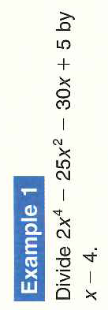
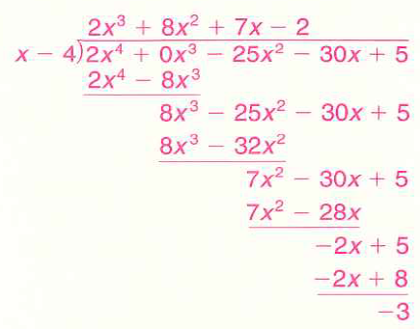
Polynomial Division – Just like long Division.
How does long division work with number?
Notice you must include all powers for the dividend

Slide 5
Your Turn: Check Answer on Pg. 241

Slide 6
Checking our Division.
15 ÷ 3 = 5 and I can check by: 3×5=15
The Division Algorithm
Remainders and Factors

Slide 7
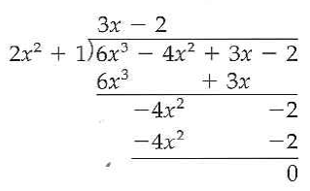
Example 2: Factors Determined by Division
It is a factor if it divides with no remainder! So check:

Slide 8
Example 3: Find the Reminder: Is the Divisor a Factor?
Remainder Theorem will help us solve easily!
Read Theorem carefully!!

Slide 9
What if the reminder was zero in our last example?:

Slide 10
Example 4: Your Turn: The Factor Theorem

Slide 11
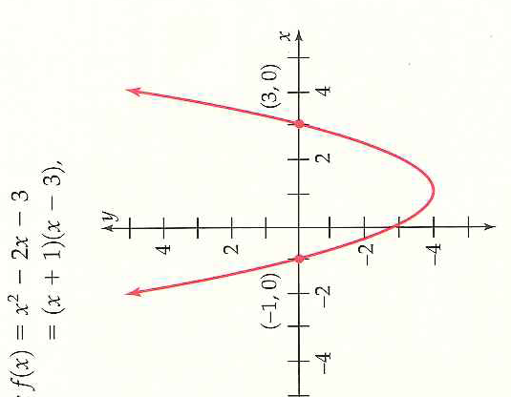
Connections: If one is true then the others will be true!!
-1 and 3 are the zeros of f.
-1 and 3 are the x-intercepts of the graph of f.
-1 and 3 are the solutions to f(x) =0 (x^2 -2x -3 =0)
x +1 and x -3 are factors of x^2 -2x -3

Slide 12
Example 5: A Polynomial with Specific Zero
What does the at most mean?

Slide 13
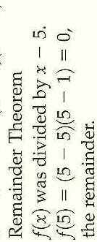
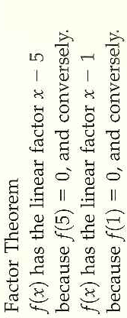
End Summary

Slide 14
4.1 HMWR p.248: 1-7odd, 17-33odd, 41, 43, 51, 55, 59

