Slide 1
4.1 Antiderivatives and Indefinite Integration
Learning Goals: We are learning about:
Antiderivatives
Notation for Antiderivatives
Basic Integration Rules
Initial Conditions and Particular Solutions
Why are we learning this?
Helps us find useful formulas! (Example 8)

Slide 2
Antiderivatives:
Find a function F whose derivative is:
Now find another function!

Slide 3
Antiderivatives

Slide 4
Example 1: Solving a Differential Equation

Slide 5
Notation for Antidertivative: Antidifferentiation/Indefinite Integration Antiderivative/Indefinite Integral
Need to find the y that makes the equation true.
Once we know the y what are we doing to it?

Slide 6
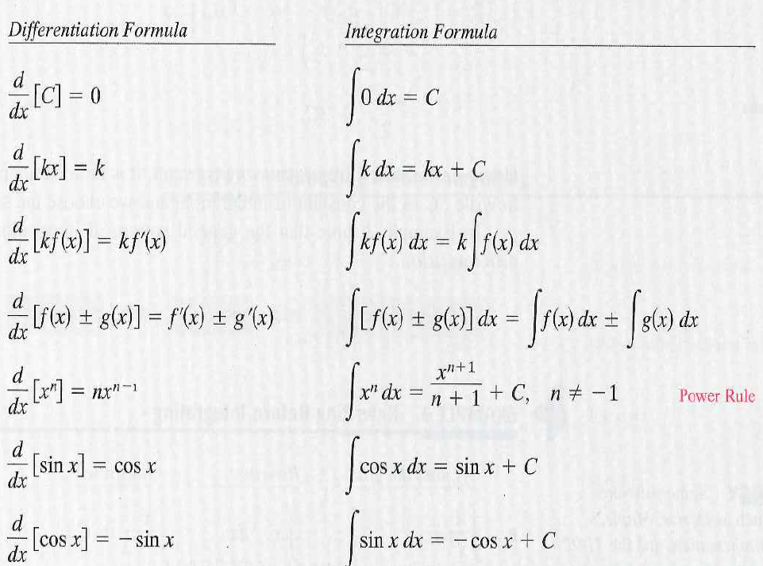
Basic Integration Rules

Slide 7
Example 2: Applying The Basic Integration Rules
Example 3: Rewriting Before Integrating

Slide 8
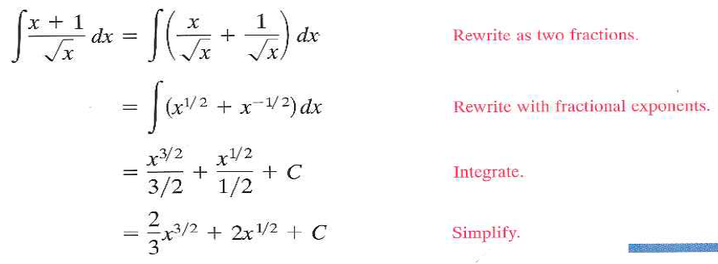
Example 5: Rewriting Before Integrating – We have no Quotient Rule
Same applies with derivatives

Slide 9
Example 6: Rewriting Before Integration Using Trig Identities

Slide 10
Example 7: Finding a Particular Solution
Particular solution?

Slide 11
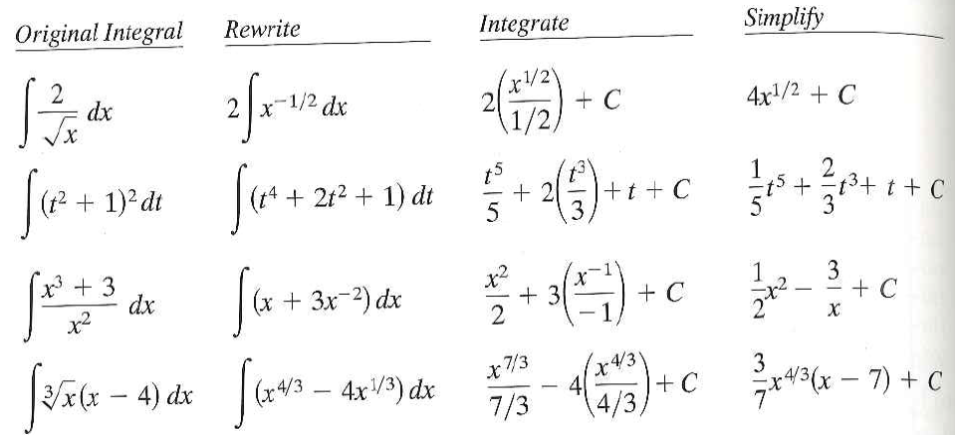
Remember we need to rewrite the integrand to fit the basic integration rules:
How does this show that integration is limited compared to differentiation?

Slide 12
Example 8 – Great Example!! Read Together. 4.1 Hmwr: 1-13odd, 17, 19, 23, 25, 29-45odd, 51, 57, 67

