Slide 1
4.1 Graphing Relationships
Objectives
Match simple graphs with situations.
Graph a relationship.
Vocabulary
continuous graph
discrete graph

Slide 2
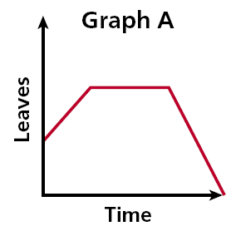
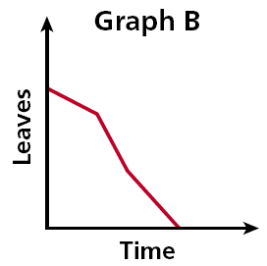
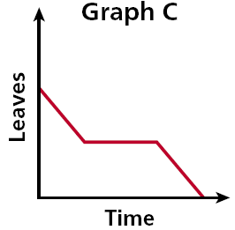
Example 1: Relating Graphs to Situations
Each day several leaves fall from a tree. One day a gust of wind blows off many leaves. Eventually, there are no more leaves on the tree. Choose the graph that best represents the situation.
Look for Key Words and then match

Slide 3
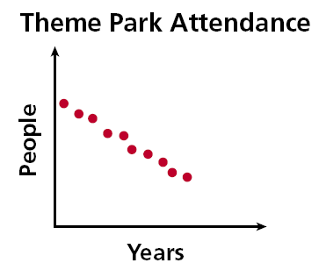
Check It Out! Example 1
The air temperature increased steadily for several hours and then remained constant. At the end of the day, the temperature increased slightly before dropping sharply. Choose the graph that best represents this situation.
Step 1 Read the graphs from left to right to show time passing .
Answer:
What do we call the graph above? ________________
When points are not connected we have a discrete graph

Slide 4
Example 2A: Sketching Graphs for Situations
Sketch a graph for the situation. Tell whether the graph is continuous or discrete:
A truck driver enters a street, drives at a constant speed, stops at a light, and then continues.
As time passes during the trip (moving left to right along the x-axis) the truck's speed (y-axis) does the following:
y
• initially increases
• remains constant
• decreases to a stop
• increases
• remains constant
Speed
Time
x
The graph is continuous.

Slide 5
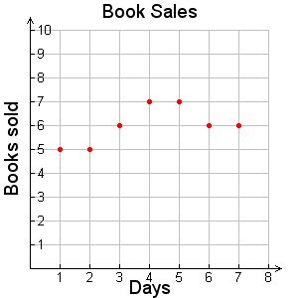
Example 2B: Sketching Graphs for Situations
Sketch a graph for the situation. Tell whether the graph is continuous or discrete.
A small bookstore sold between 5 and 8 books each day for 7 days.
The number of books sold (y-axis) varies for each day (x-axis).
Since the bookstore accounts for the number of books sold at the end of each day, the graph is 7 distinct points.
The graph is discrete.

Slide 6
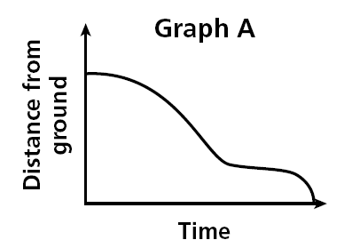
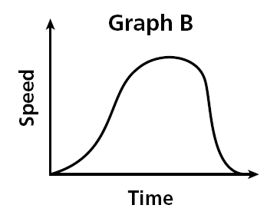
Both graphs show a relationship about a child going down a slide. Graph A represents the child’s distance from the ground related to time. Graph B represents the child’s Speed related to time.
Let’s interpret these graphs... What is happening?

Slide 7
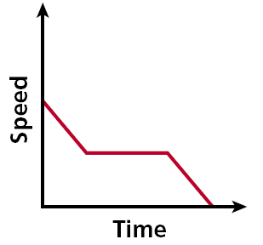
Example 3: Writing Situations for Graphs
Write a possible situation for the given graph.
Step 1 Identify labels.
x-axis: time y-axis: speed
Step 2 Analyze sections.
over time, the speed:
• initially declines,
• remains constant,
• and then declines to zero.
Possible Situation:
A car approaching traffic slows down, drives at a constant speed, and then slows down until coming to a complete stop.
Write down your own example and then share it with your neighbour!

Slide 8
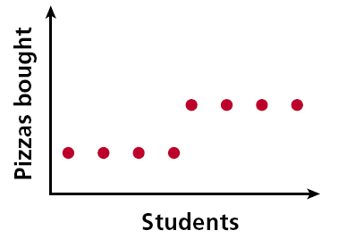
Check It Out! Example 3
Write a possible situation for the given graph
Step 1 Identify labels.
x-axis: students y-axis: pizzas
Step 2 Analyze sections.
As students increase, the pizzas do the following:
• initially remains constant,
• and then increases to a new constant.
Possible Situation:
When the number of students reaches a certain point, the number of pizzas bought increases.

