Slide 1
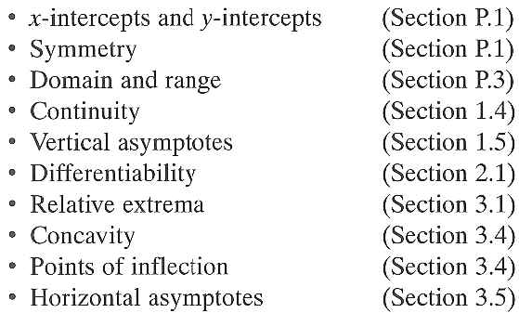
3.6 A Summary of Curve Sketching
Learn Targets:
Learn how to do a good sketch of different graphs
Why learn this?

Slide 2
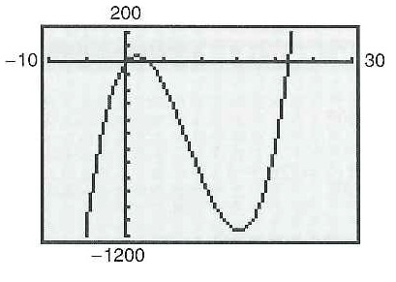
Cannot Just Use a Graphing Calculator to Graph all Functions:
In order to know what viewing window or windows on a graphing calculator would be best we need calculus
The 2nd viewing window is better but a 3rd viewing window might show other interesting points

Slide 3
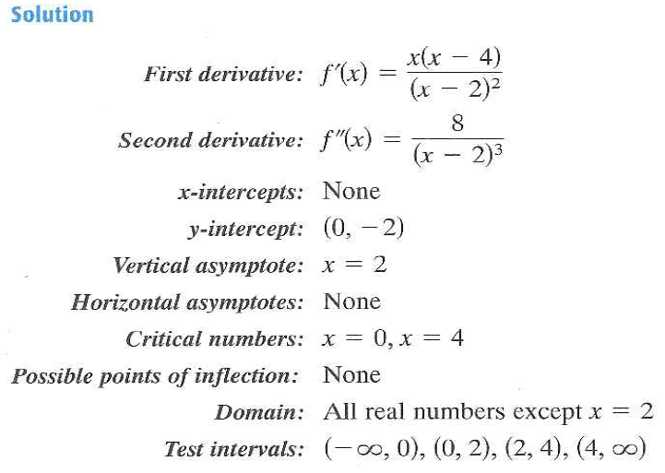
Example 2: Analyze the Graph of a Rational Function

Slide 4
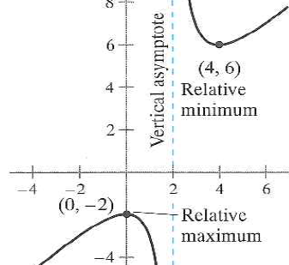
Example 2 Continued

Slide 5
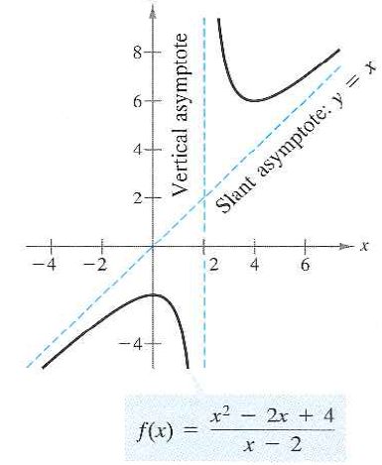
Horizontal Asymptotes Vs. Slant Asymptotes
Let`s practice our division!

Slide 6
Example 4: Analyzing the Graph of a Radical Function

Slide 7
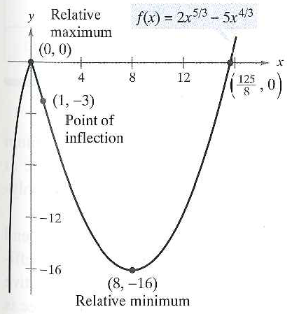

Slide 8
Example 5: Analyzing the Graph of a Polynomial Function
How do this factor. Let`s review!

Slide 9
3.6 Hmwr: 17, 23, 39... More to come☺

