Slide 1
3.6 Solving Linear Systems in Three Variables
Objectives
Solve systems of equations in three dimensions algebraically.
Represent solutions to systems of equations in three dimensions graphically.
Holt Algebra 2

Slide 2
Warm Up/What do the graphs of these equations look like?
Solve each system of equations algebraically.
Classify each system and determine the number of solutions.
x = 4y + 10
6x – 5y = 9
1.
(2, –2)
2.
(–1,–3)
4x + 2y = 4
2x – y =1
3x – y = 8
x = 3y – 1
3.
4.
6x – 2y = 2
6x – 12y = –4
inconsistent; none
consistent, independent; one

Slide 3
Example 1: Solving a Linear System in Three Variables
Use elimination to solve the system of equations.
5x – 2y – 3z = –7
1
2x – 3y + z = –16
2
3x + 4y – 2z = 7
3
Step 1 Eliminate one variable.
In this system, z is a reasonable choice to eliminate first because the coefficient of z in the second equation is 1 and z is easy to eliminate from the other equations.
My Game Plan is?

Slide 4
Example 1 Continued
1
5x – 2y – 3z = –7
5x – 2y – 3z = –7
Multiply equation - by 3, and add to equation .
2
3(2x –3y + z = –16)
6x – 9y + 3z = –48
2
1
11x – 11y = –55
4
Use equations and to create a second equation in x and y.
3
2
1
3
3x + 4y – 2z = 7
3x + 4y – 2z = 7
Multiply equation - by 2, and add to equation .
2
2(2x –3y + z = –16)
4x – 6y + 2z = –32
2
3
7x – 2y = –25
5

Slide 5
Example 1 Continued
11x – 11y = –55
4
You now have a 2-by-2 system.
7x – 2y = –25
5

Slide 6
Example 1 Continued
Step 2 Eliminate another variable. Then solve for the remaining variable.
You can eliminate y by using methods from Lesson 3-2.
–2(11x – 11y = –55)
–22x + 22y = 110
Multiply equation - by –2, and equation - by 11 and add.
4
1
11(7x – 2y = –25)
77x – 22y = –275
4
5
5
55x = –165
1
x = –3
Solve for x.

Slide 7
Example 1 Continued
Step 3 Use one of the equations in your 2-by-2 system to solve for y.
4
11x – 11y = –55
1
11(–3) – 11y = –55
Substitute –3 for x.
1
y = 2
Solve for y.

Slide 8
Example 1 Continued
Step 4 Substitute for x and y in one of the original equations to solve for z.
2x – 3y + z = –16
2
Substitute –3 for x and 2 for y.
2(–3) – 3(2) + z = –16
1
z = –4
Solve for y.
1
The solution is (–3, 2, –4).

Slide 9
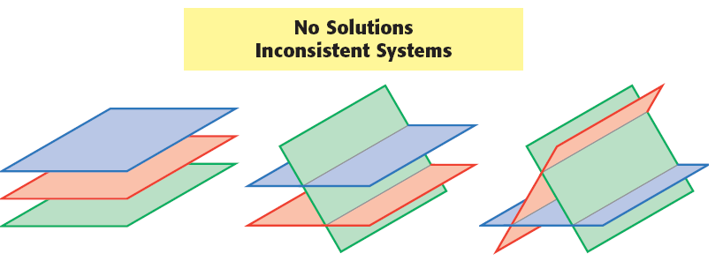
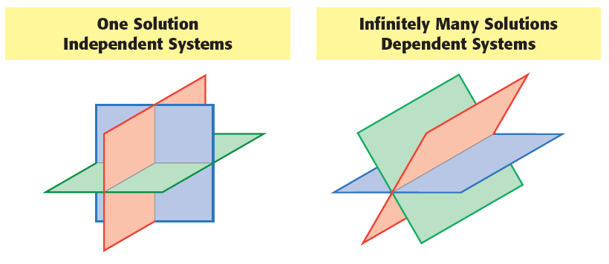

Slide 10
Example 2: Classifying Systems with Infinite Many Solutions or No Solutions
Classify the system as consistent or inconsistent, and determine the number of solutions.
2x – 6y + 4z = 2
1
–3x + 9y – 6z = –3
2
5x – 15y + 10z = 5
3

Slide 11
Example 2 Continued
The elimination method is convenient because the numbers you need to multiply the equations are small.
First, eliminate x.
Multiply equation by 3 and equation by 2 and add.
1
2
1
3(2x – 6y + 4z = 2)
6x – 18y + 12z = 6
2(–3x + 9y – 6z = –3)
–6x + 18y – 12z = –6
2
0 = 0
✓

Slide 12
Example 2 Continued
Multiply equation by 5 and equation by –2 and add.
1
3
1
5(2x – 6y + 4z = 2)
10x – 30y + 20z = 10
–2(5x – 15y + 10z = 5)
–10x + 30y – 20z = –10
3
0 = 0
✓
Because 0 is always equal to 0, the equation is an identity. Therefore, the system is consistent, dependent and has an infinite number of solutions.

Slide 13
Check It Out! Example 2b
Classify the system, and determine the number of solutions.
2x – y + 3z = 6
1
2x – 4y + 6z = 10
2
y – z = –2
3

Slide 14
Check It Out! Example 2b Continued
Use the substitution method. Solve for y in equation 3.
y – z = –2
Solve for y.
3
y = z – 2
4
Substitute equation in for y in equation .
4
1
2x – y + 3z = 6
2x – (z – 2) + 3z = 6
2x – z + 2 + 3z = 6
2x + 2z = 4
5

Slide 15
Check It Out! Example 2b Continued
Substitute equation in for y in equation .
4
2
2x – 4y + 6z = 10
2x – 4(z – 2) + 6z = 10
2x – 4z + 8 + 6z = 10
2x + 2z = 2
6
Now you have a 2-by-2 system.
2x + 2z = 4
5
2x + 2z = 2
6

Slide 16
Check It Out! Example 2b Continued
Eliminate z.
5
2x + 2z = 4
–1(2x + 2z = 2)
6
0 ≠ 2 ✗
Because 0 is never equal to 2, the equation is a contradiction. Therefore, the system is inconsistent and has no solutions.

Slide 17
Example 3
Jada’s chili won first place at the winter fair. The table shows the results of the voting.
How many points are first-, second-, and third-place votes worth?
Winter Fair Chili Cook-off
Name | 1st Place | 2nd Place | 3rd Place | Total Points
Jada | 3 | 1 | 4 | 15
Maria | 2 | 4 | 0 | 14
Al | 2 | 2 | 3 | 13

Slide 18
Example 3 Continued
Step 1 Let x represent first-place points, y represent second-place points, and z represent third- place points.
Write a system of equations to represent the data in the table.
3x + y + 4z = 15
1
Jada’s points.
2x + 4y = 14
2
Maria’s points.
2x + 2y + 3z = 13
3
Al’s points.
A variable is “missing” in one equation; however, the same solution methods apply. Elimination is a good choice because eliminating z is straightforward.

Slide 19
Example 3 Continued
Step 2 Eliminate z.
Multiply equation by 3 and equation by –4 and add.
1
3
1
3(3x + y + 4z = 15)
9x + 3y + 12z = 45
–4(2x + 2y + 3z = 13)
–8x – 8y – 12z = –52
3
x – 5y = –7
4
Multiply equation by –2 and add to equation .
4
2
4
–2(x – 5y = –7)
–2x + 10y = 14
2
2x + 4y = 14
2x + 4y = 14
y = 2
Solve for y.

Slide 20
Example 3 Continued
Step 3 Use equation to solve for x.
2
2
2x + 4y = 14
Substitute 2 for y.
2x + 4(2) = 14
Solve for x.
x = 3
Step 4 Substitute for x and y in one of the original equations to solve for z.
3
2x + 2y + 3z = 13
2(3) + 2(2) + 3z = 13
6 + 4 + 3z = 13
z = 1
Solve for z.
The solution to the system is (3, 2, 1). The points for first-place is 3, the points for second-place is 2, and 1 point for third-place.

