Slide 1
Calculus Review 3.5/Preview 3.6

Slide 2
Guidelines for Finding Limits of Rational Functions

Slide 3
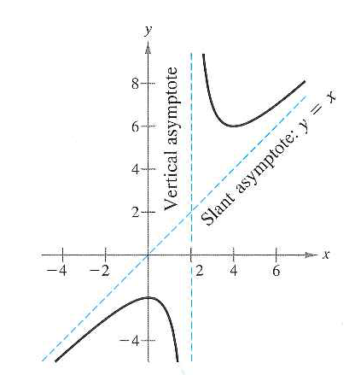
Slant Asymptotes
The graph of a rational function having no common factors has a slant asymptote if the degree of the numerator exceeds the degree of the denominator by 1
Use long division to find the slant asymptote!

Slide 4
Let Us Practice!

